Slide 1
RDz Workbench – Using the Data Source Explorer
Author: Jon Sayles, Enterprise Modernization EcoSystems Team
Notes:
This module will require approximately 30 minutes to complete:

Slide 2
IBM Trademarks and Copyrights
  © Copyright IBM Corporation 2007,2008, 2009. All rights reserved.
  The information contained in these materials is provided for informational purposes only, and is provided AS IS without warranty of any kind, express or implied. IBM shall not be responsible for any damages arising out of the use of, or otherwise related to, these materials. Nothing contained in these materials is intended to, nor shall have the effect of, creating any warranties or representations from IBM or its suppliers or licensors, or altering the terms and conditions of the applicable license agreement governing the use of IBM software. References in these materials to IBM products, programs, or services do not imply that they will be available in all countries in which IBM operates.
  This information is based on current IBM product plans and strategy, which are subject to change by IBM without notice. Product release dates and/or capabilities referenced in these materials may change at any time at IBM’s sole discretion based on market opportunities or other factors, and are not intended to be a commitment to future product or feature availability in any way.
  IBM, the IBM logo, the on-demand business logo, Rational, the Rational logo, and other IBM Rational products and services are trademarks or registered trademarks of the International Business Machines Corporation, in the United States, other countries or both. Other company, product, or service names may be trademarks or service marks of others.

Slide 3

Course Contributing Authors
Thanks to the following individuals, for assisting with this course:
  Reginaldo Barosa/IBM
  David Bean/IBM

Slide 4
Course Overview
Audience
  This course is designed for application developers who have learned or programmed in COBOL, and who need to do z/OS Traditional Development and Maintenance as well as build leading-edge applications using COBOL and Rational Developer for System z.
Prerequisites
  This course assumes that the student has a basic understanding and knowledge of software computing technologies, and general data processing terms, concepts and vocabulary, as well as a working knowledge of COBOL and z/OS.
  Knowledge of SQL (Structured Query Language) is assumed for database access is assumed as well.
  Basic PC and mouse-driven development skills, terms and concepts are also assumed.

Slide 5
Course Topics
Course Name: Rational Developer for System z Foundation Training
Course Description: Learn how to use Rational Developer for System z to do z/OS traditional development, maintenance, support and for Enterprise Modernization of z/OS applications
Pre-requisites: Some experience developing COBOL applications using z/OS is expected. A working knowledge of SQL is also recommended.
Course Length: ~5days – or if done in self-paced mode, at your own pace
Topics (Agenda)
    Getting Started - installing and configuring RDz - and the course materials, and using Eclipse
    The RDz Workbench
      Code analysis tools
      Editing
      Compiling programs
      Debugging local COBOL programs
    The Data Perspective:
      Working with relational data sources
      Modifying test data
      Editing and testing SQL statements
    Working with remote system resources:
      Connecting to a mainframe
      Data management
      Accessing and editing files
    z/OS Application Development
      Creating MVS Subprojects
      Creating and customizing project properties
    Debugging z/OS Applications
      Debugging Batch Applications
      Setting Debug Tool for Online Applications
    Working with File Manager
      Creating test data
      Editing complex file-types
    Working with mainframe ABENDs using Fault Analyzer
      Creating Fault History views
      Analyzing and solving mainframe ABENDs
    Creating and modifying BMS Maps using the BMS Map Editor

Slide 6
Topic objectives
After completing this topic, you should be able to:
  Use the RDz Data Perspective to:
    Connect to local and remote databases
    Edit test data interactively
    Display results of SQL queries
    Perform DBA activities on tables in a local database
    Display the data model for your application/DB2 tables and views
 Note: In this topic you will be connecting to a local copy of a DB2 (or UDB) database through the tools in the Data Perspective.
The Data Perspective's procedures and tools are very simple. So simple in fact, that you may wish to connect to your own database while (!) you're working through these slides.
If you wish to connect to the sample database shown in these slides, please contact IBM to obtain the:
  DDL (Data Definition Language statements, used to define the table schema)
  Extracted data for importing
These tables and views are used in the COBOL/DB2 unit of the course.
Final note – this section assumes you have at least a working-knowledge of SQL. If you do not, please see the next slide for learning-source links.

Slide 7

Learning DB2 and SQL
Many (in the thousands of) books exist that do an excellent job teaching SQL.
Additionally, sites exist on the Internet (GOOGLE: “SQL tutorials” – or “Learn SQL”) for online (and typically free) education.
IBM Also supplies excellent SQL and DB2 documentation:
  DB2 Documentation
  SQL Getting Started
  SQL Reference Manual
  Message (error code) Reference. Cached pdf version of full guide.
  DB2 Application Development Guide with example embedded SQL programs.
  Triggers in DB2
  Constraints in DB2
Note: as before, in order for you to get the above links to work, run the PowerPoint in Slide Show mode.
Here’s an example of COBOL database access:
  http://publib.boulder.ibm.com/infocenter/dzichelp/v2r2/index.jsp?topic=/com.ibm.db29.doc.apsg/db2z_samplecoboldrdathreepartnames.htm
*** Notes
Notes:
Notes – The examples and labs in this section use Derby and DB2 as the RDBMS. And in the text we often refer to “DB2” generically. When of course there are many excellent RDBMS products in use, such as: Informix, Oracle, SQLServer, Teradata, Sybase, MySQL,etc (although not all of these are supported COBOL platforms).
For the most part, what you learn in this section is applicable to any IBM-supported RDBMS platform. With the exception being that certain SQL statements may or may not be supported by the different vendors – as they may be non-standard (not ANSI-standard) SQL verbs and operations.

Slide 8
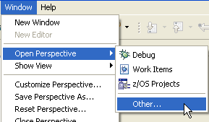
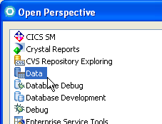
The RDz Data Tools
The RDz Data Tools allow you to access your data sources, and to view and add test rows, edit your tables, create and test/execute SQL statements interactively.
Access the Data Perspective from the Window menu
  Window > Open Perspective > Other… > Data
The Data Perspective has a number views and tools you will work with:
  Data Source Explorer
    Shows Connections – which contain
      Schemas and tables
      Processing options
    Data Output
      Shows the results of running SQL queries
  Data Project Explorer
    For Data Analysts
  SQL Statement Wizard
    For building SQL statements interactively
Data Tools
Notes:
Notes:

Slide 9


Why use the RDz Data Tools?
But, we currently use SPUFI and QMF for doing DB2 work, why should we change?
Simple…
  1. Functionality:
    The RDz Data Tools have vastly superior means of:
      SQL statement testing
      Managing your DB2 table test data
        Full-screen table editing
        Simple data export/import
      Doing DBA tasks
      Understanding your relational data model
    Easy access from the RDz Workbench
      The tools are completely integrated into eclipse
  2. Cost - z/OS MIPS reduction:
    RDz is substantially less expensive than TSO/SPUFI or QMF for doing DB2/SQL development

Slide 10
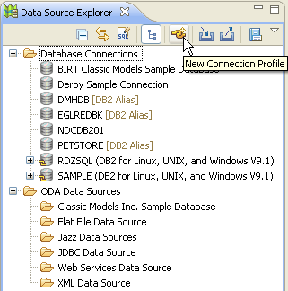
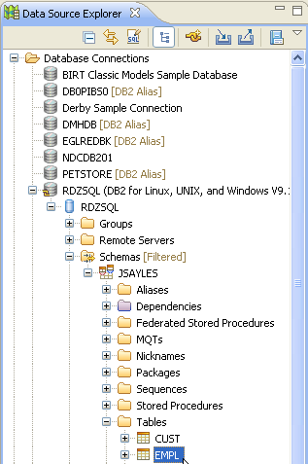
The Data Source Explorer
All of your work in the Data Perspective is done through a database Connection. In this course our Data Source Explorer screen captures show four connections – your machine may have more or less, depending on the databases you have access to.
In the Data Perspective, you can define a new Connection or reconnect to a database through an existing connection (like the one you’ve been using in debug, and used for the SQL Access Application import earlier in this course)
You are “connected” and can:
  Expand folders
  Use the Data Perspective
    Tools
    Views
    Wizards
Notes:
Notes:

Slide 11

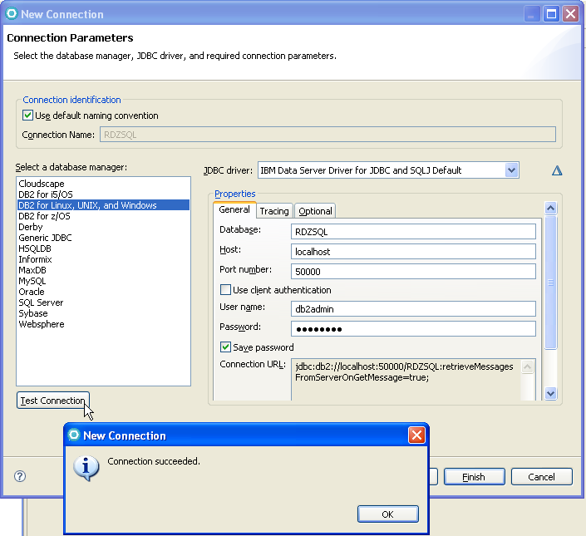
Creating a new Connection to a Database
You will need the:
  Database name
  Host + Port number
    IP address if shared/network or mainframe DB2
    localhost if on your Windows machine
  User ID
  Password
Note that the connection properties are installation and DBMS dependent:
  DB2 for z/OS requires a "Location" as well as Host name and port number.
  You would work with your DBA and systems programmer to get these values
Notes
Notes:
Notes on the JDBC URL:
In case it helps, DB2 URL is -> jdbc:db2://<hostname>:<port>/databaseName. The different parameters are:
hostname: the NetBios name for the computer, as defined in hosts file, in the case of Linux. If it's your PC, you may either use the loopback TCP/IP address (127.0.0.1) or the keyword "localhost"
port: the port where DB2 is listening to clients. Default is TCP port 50000; you may check where is your DB2 installation listening, issuing the DB2 command GET DBM CFG from a command line processor (CLP) or via the DB2 Configuration Assistant. In the first case, check the parameter SVCENAME. In case you want to change the port number, issue the DB2 command UPDATE DBM CFG USING SVCENAME svcnum, where svcnum is the desired port number.
databaseName: the name of the database you want to work with. If you don't know it, the DB2 Control Center is a good place to start.

Slide 12
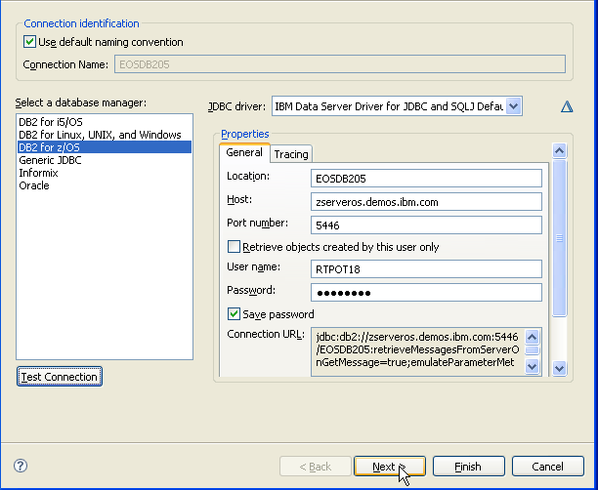
Connecting to DB2 on z/OS
On z/OS you will need to provide a few different pieces of information, in order to connect:
  Location:
    Your DB2 DSN
  Host:
    The URL/IP Address
  Do NOT check:
    Retrieve objects created
    by this user only
  UserID/Password:
    Required
Select: DB2 for z/OS as the database manager
Click Test Connection
If all is good…
Click Next >

Slide 13
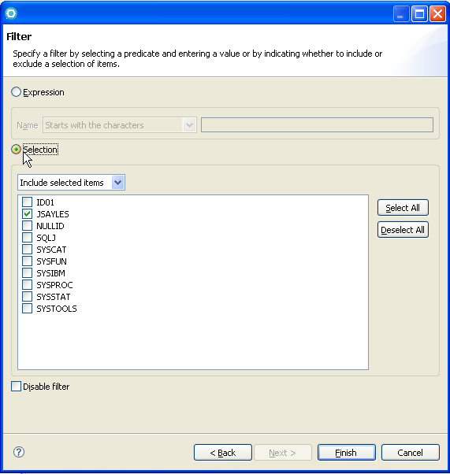
Filtering Schemas and Tables
In this course the databases contain a few tables.
In your world, databases could easily contain:
  Tens of thousands of tables
  Hundreds of Schemas
To simplify working with your DB2 objects you will filter schemas
Two options:
  By individual Schema selection (checkboxes)
  With an SQL "LIKE" expression to filter the Schemas
Note that you can re-filter Schemas, Stored Procedures and Tables at any time (you'll see how in a minute)

Slide 14
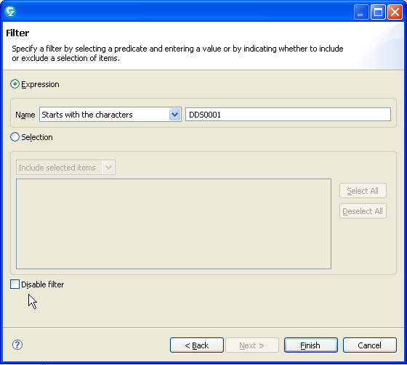
Filtering Schemas and Tables – DB2 on z/OS
In the DB2 mainframe world on z/OS databases could easily contain:
    Tens of thousands of tables
    Thousands of Schemas
To simplify working on your projects filter the available DB2 objects
Un-check: □ Disable Filter
Enter: DDS0001
  In: ◙ Expression name

Slide 15
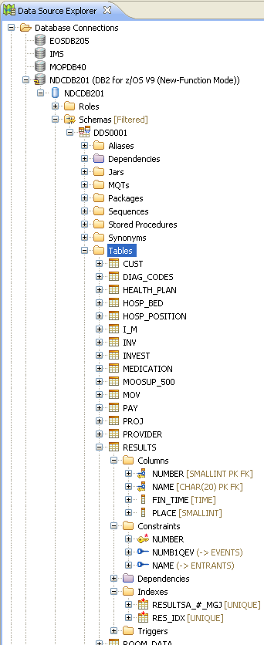
The Data Source Explorer – Connected
Once you're connected, the Data Source Explorer organizes meta-data about RDBMS objects accessible through your connection as follows:
  Databases within the connection
  Schemas (the high-level qualifier of the resource owner)
  The following relational object resources (DBMS-dependent):
    Synonyms
    Dependencies
    Stored Procedures
    (if DB2 for z) – Federated Stored Procedures
    Tables and within tables:
      Column definitions
      Relational constraints (primary and foreign key rules)
      Indexes
      Triggers
      User-defined functions
    Views
The Properties view can be helpful in expanding the information presented.
Many additional context menu options exist off these entries
Notes:
Notes:

Slide 16
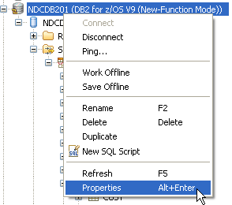
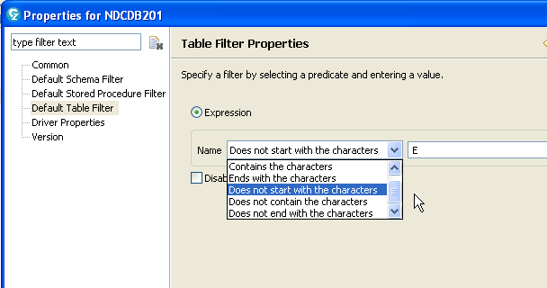
Filtering The Data Source Explorer (on the fly)
The connection you create to DB2 is based on a default filter for schema names, but you're not limited to that at all.
To re-filter your data objects:
  Select the connection
  Right-click and select Properties
From Properties you can re-filter:
  Schema names
  Stored Procedures
  Tables
Steps:
Select the filter
Un-check Disable filter
Specify your new filter
Click OK

Slide 17
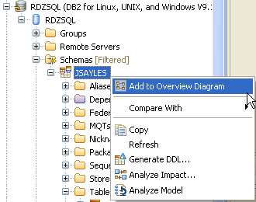
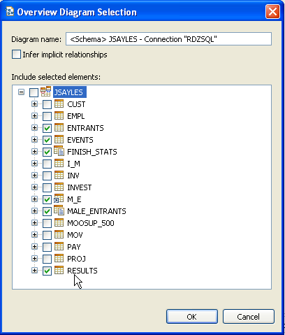
(Data Model) Overview Diagram – 1 of 5
So what can we do with the Data Source Explorer? Let’s start by having a look at our tables and their relationships.
From the Data Source Explorer view
  Expand a folder for a database and navigate the schemas:
    Right-click a schema select: Add to Overview Diagram
    Select the tables, views, synonyms, etc. you wish to see
◉ Note:
The Overview Diagram feature is available in RDz version 7.6.1
Notes:
Notes:

Slide 18
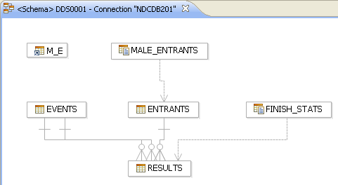
(Data Model) Overview Diagram – 2 of 5
The Diagram Tool shows all of the tables, views and synonyms selected through our connection as entities, and their relationships as defined by Primary/Foreign key SQL specifications. This allows us to understand things like how to join tables, and where data exists in relation to other table values.
We can also use the Diagram Tool to navigate in the Data Source Explorer
  Right-click over Results
  Select:
    Navigate >
    Show in >
    Database Explorer
Note the different icons for:
  Tables:
    Events
    Entrants
    Results
  Views:
    Finish_Stats
    Male_Entrants
  Synonym:
    M_E
Note: If you select a large number of tables this diagram can take some time to materialize
Notes:
Notes:

Slide 19
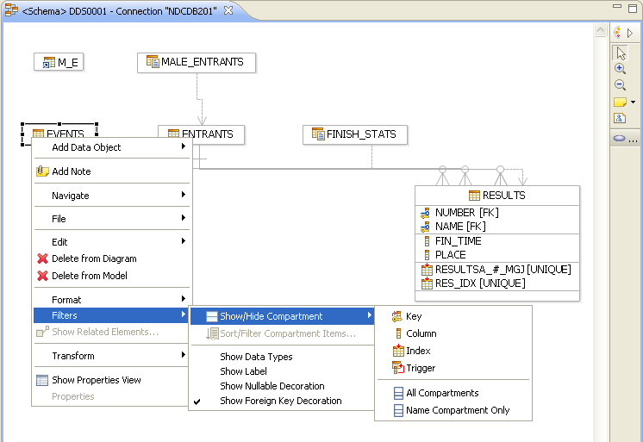
(Data Model) Overview Diagram – 3 of 5
By default, the Overview Diagram shows only DB2 object names and their relationships. You might wish to show additional attributes. To do this:
Select the object
  Right-click and select:
    Filters > Show/Hide Compartment > <your option>
Notes:
Notes:

Slide 20
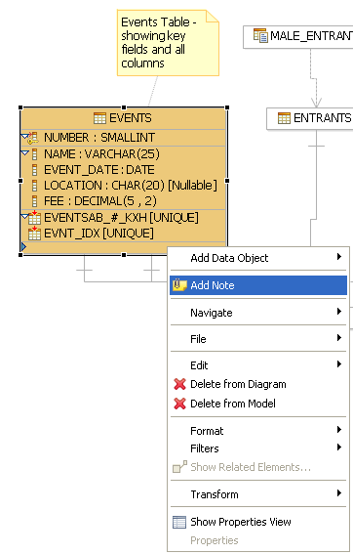
(Data Model) Overview Diagram– 4 of 5 (optional features)
If you are a database administrator (acting database administrator for your local copy of a database) or data modeler/data analyst you might be interested in other context menu options:
We can also use the Diagram Tool to do other DBA work:
  Right-click over the EVENTS entity
  Select:
    Add note
    Type text into the edit area
    When finished,
      Click the diagram again with your mouse
      You can delete the note by selecting it
        Right-click and select Delete
  Other context menu options of interest:
    Right click over the white space (not over an entity)
    Zoom
      In or out to scale
    File
      Save image
Notes:
Notes:

Slide 21
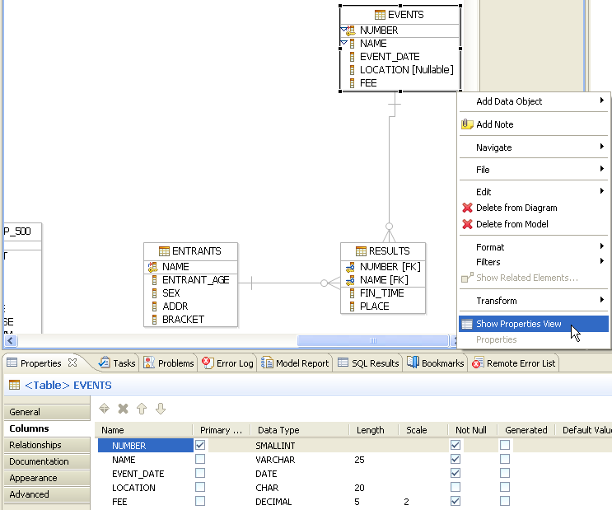
(Data Model) Overview Diagram– 5 of 5 (Properties View)
Another useful DBA view – that provides meta data for:
Tables
Relationships (click the lines drawn between the entities)
Views
Notes:
Notes:

Slide 22

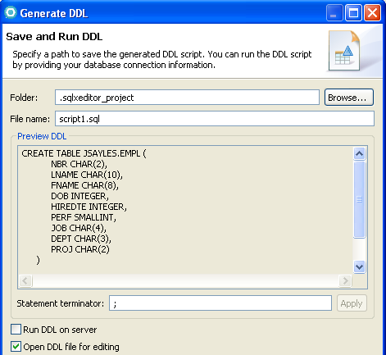
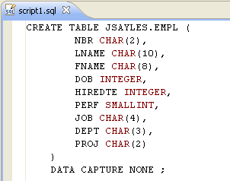
Additional DBA Features – Generate Table DDL
You may wish to modify one or more of your table's DDL, and confine the modification to your local UDB copy. To do this you'll need the original DDL
From the Data Source Explorer:
  Right-click over the table name
  Select: Generate DDL…
  Follow the wizard
    Check/Un-check selections
Notes:
Notes:

Slide 23
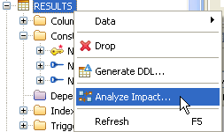
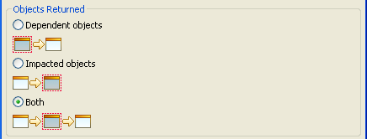
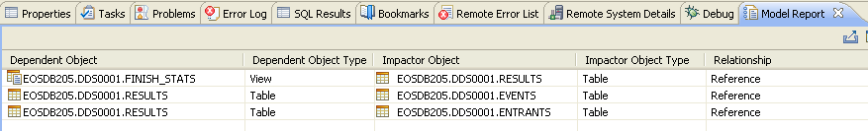
DBA/SQL Programmer Feature – Analyze Impact
For tables with DB2-enabled "Referential Integrity"
  Select a table (either parent or child table)
    Note that the table should have constraints
  Right-click and select: Analyze Impact…
  Select the type of analysis to perform
    Only children objects
    Only parent objects
    Both children/parent objects
  Click OK
Read the Model report produced
  Dependent Object is the "child" table or view that will be impacted
  "Impactor Object" is the parent table or view (of what has been analyzed)

Slide 24
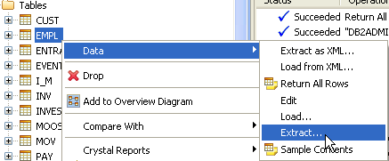
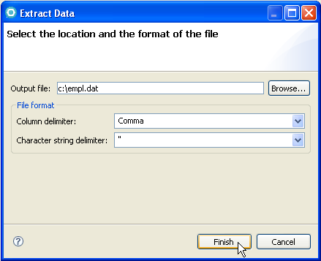
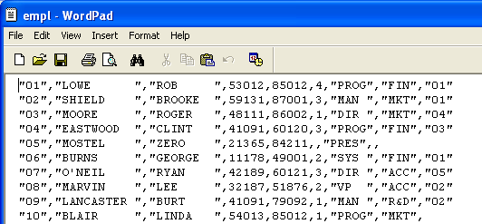
Unload (Extract) Rows from a Table
You also might wish to unload (extract) test data rows before modifying a table's DDL, either for back-up purposes or to share among team members or re-load later.
From the Data Source Explorer:
  Right-click over the table name
  Select: Data >
    Extract…
  Specify data extract (unload) options:
    Output file-spec
    Column delimiter type
    Char-string delimiter type
To reload select: Load…
  and follow script in reverse
Notes:
Notes:

Slide 25
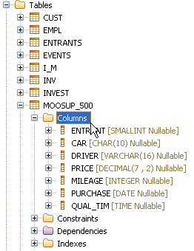
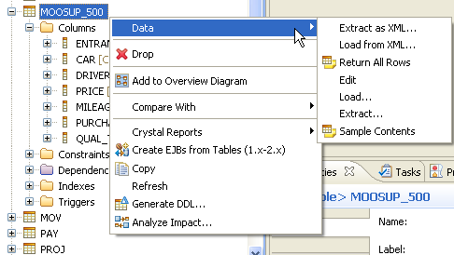
Exploring a Table
The Data Source Explorer allows you to:
  View a table’s schema
    Columns and Referential Integrity Constraints and Indexes
  Through the Context Menu:
    Create the SQL data definition language statements to create the table
    From Data >
      View the table contents (Sample Contents)
      Edit table values
      Extract and load the table using a comma-delimited file
Data Source Explorer - Context Menu, Data options
Viewing a table's column definitions
Notes:
Notes:

Slide 26
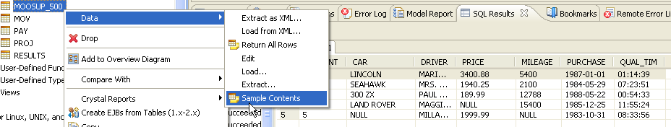
Sample Table Contents
When you are testing your SQL statements, it is extremely important to be able to view the row and column values in your tables. Sample Contents provides this, in a SQL Results view.
Note that this is essentially a Select * from <schema.table>
  The # of rows returned is configurable in the Preferences (next slide)
    Consider using the SQL Scrapbook to write a query that filters the result table (next topic)
Additional options exist to save and reuse the results set:
Right-click over the rows in the SQL Results view (and/or press the Shift key and select multiple rows)
You can:
  Copy rows and Paste specific results rows into Notepad file
  Export results rows – as comma-delimited files
  Save results rows
Notes:
Notes:

Slide 27
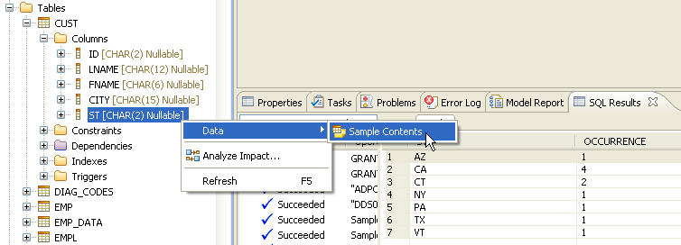
Sample Table Contents – at the Column Level
It can also be quite helpful to view the sample contents of individual columns – for various reasons:
  Applications:
    Test data coverage
    Testing and debugging values
  DBA:
    Candidate indexing
    SQL performance issues
Steps:
Select a table
Expand Columns, and select a column
Right-click
Select:
  Data
  Sample Contents
Sample Contents of a table column
1. Discreet column values
2. The number of occurrences found in the table for each value (Cardinality)
Notes:
Notes:

Slide 28
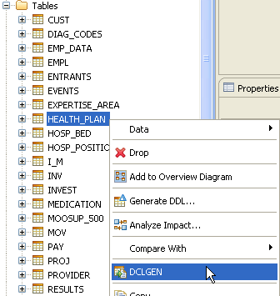
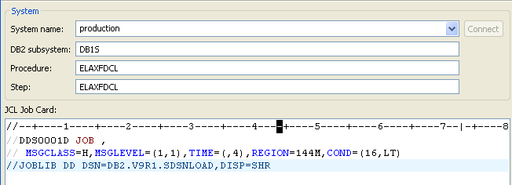
DCLGEN – 1 of 4
DCLGEN – Allows you to create copybooks from table schemas for: COBOL, PL/I, C, and Java
Steps – from the Data Perspective:
  Highlight the table you want
  Right-click and select: DCLGEN
Using the DCLGEN wizard
  Connect to the host System
  Specify the DB2 subsystem
  Customize the JCL JOB Card, Add //JOBLIB
    DD card (to reference your shop's DB2 library list)
  Click: Next >

Slide 29
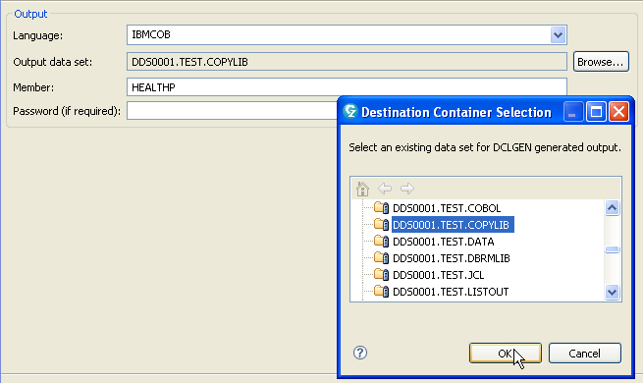
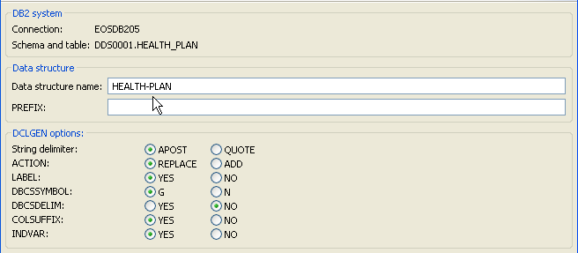
DCLGEN – 2 of 4
Select:
  Language
  Browse to select your DCLGEN output PDS
  Rename the PDS member
  Click Next >
⬅ Customize the DCLGEN-specific options
Note that at minimum, you will probably have to change the Data structure name
Click Finish
See Slide Notes
Notes:
COBOL Language options:
IBMCOB is Enterprise COBOL
COBOL is for OS/VS COBOL
COB2 is for other COBOL dialects

Slide 30
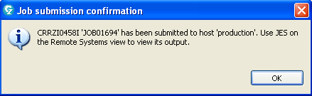
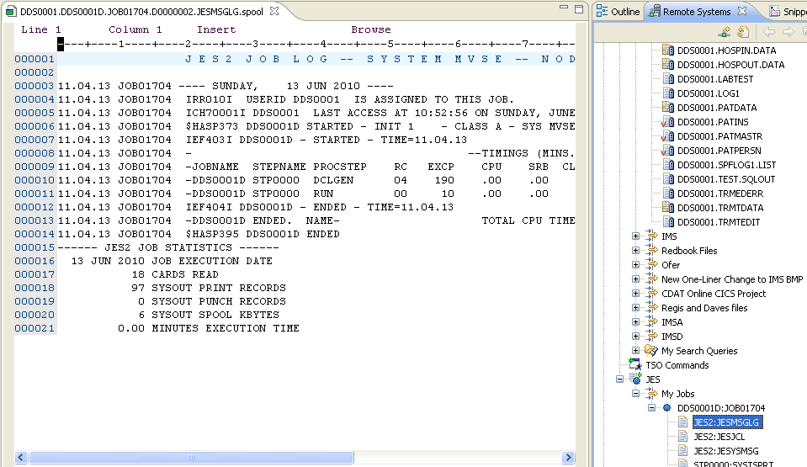
DCLGEN – 3 of 4
The wizard will submit a job, which you can track in the:
  z/OS Projects Perspective
  JES facility

Slide 31
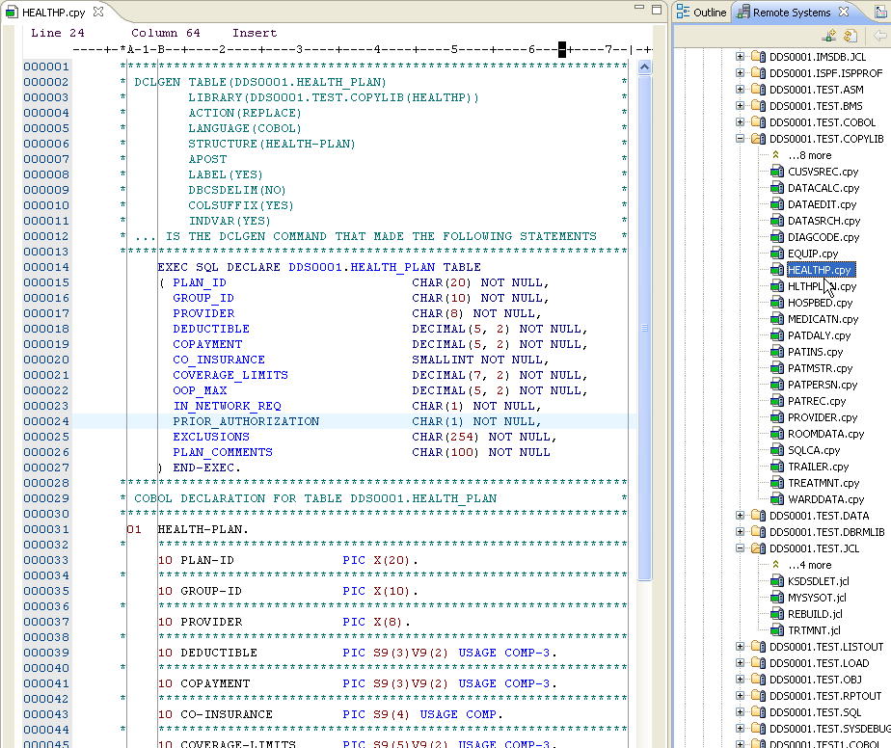
DCLGEN – 4 of 4
From Remote Systems explorer you can also open the PDS and look at your DCLGEN'd source ➔

Slide 32
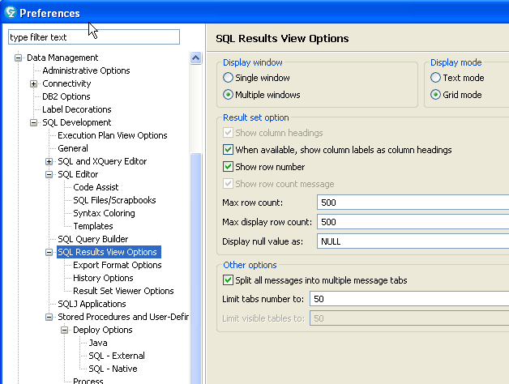
Customizing Your Data Perspective Work
A number of options are available for managing, controlling and customizing the behavior of the features in the Data Perspective
All available from:
  Window
    Preferences
      Data Management
        SQL Development
Customize the SQL Query Results

Slide 33
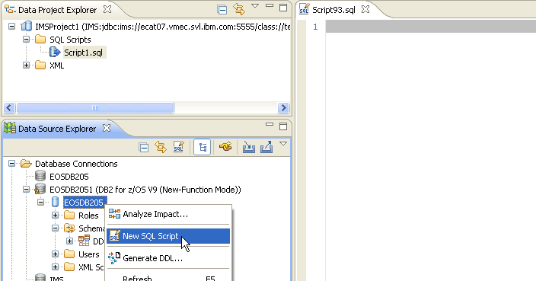
Build SQL Statements – SQL Script
A SQL Script is a file that contains interactive - not embedded - SQL statements (SQL statements without host-variables).
These statements can be tested in the Data Perspective before embedding them in COBOL data access functions. For complex SQL logic, this is recommended “best practice”.
To open and work with a SQL Script:
  From the Data Source Explorer
  Right-click over the DB2 system icon shown and select: New SQL Script
Notes:
Notes:

Slide 34
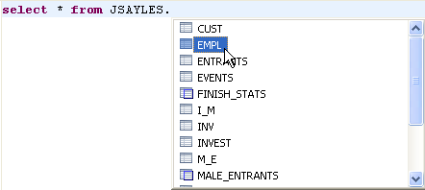
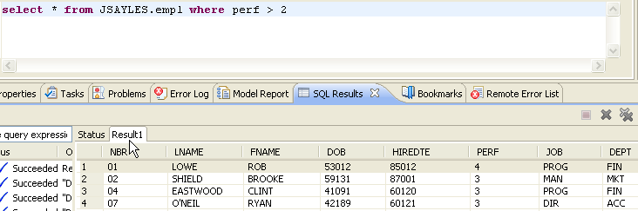
Create and Run a SQL Script Statement
 You can code your SQL statements using Content Assist – to get the table names and SQL keywords (Ctrl/Spacebar)
 Right-click (context Menu) over the statement
Select Execute Current Text
(or Execute All)
View the SQL Results
Notes:
Notes:

Slide 35

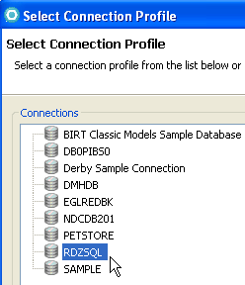
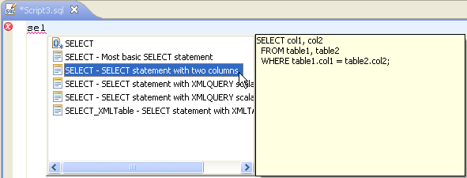
Alternative Way to Access New SQL Script
Data Source Explorer also has the New SQL Script functionality as an icon on the toolbar
  From the Data Source Explorer
  Click the New SQL Script icon
  Choose a Database connection
    Note that this is the difference from the prior slide – that you can choose a connection
  Using Content Assist – create your statement one SQL element at a time
    Some SQL syntax errors are flagged dynamically
Notes:
Notes:

Slide 36
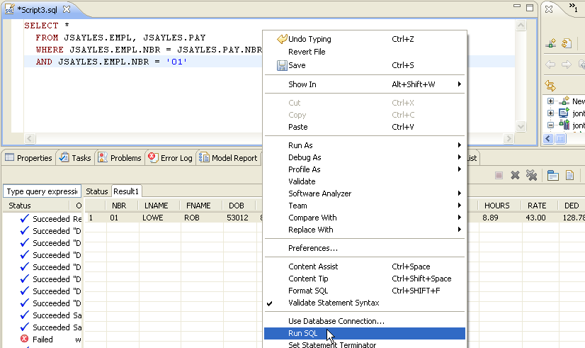
New SQL Script – Run SQL
 When you are finished coding
  1. Right-click over the script area
  2. Select Run SQL
  3. Verify your results
  Note that the Status will show details on your statement's execution
Notes:
Notes:

Slide 37
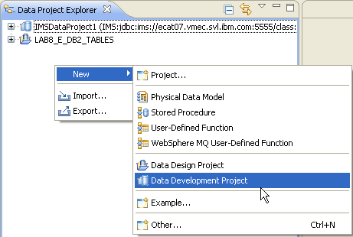

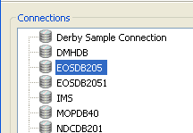
SQL Statement GUI-Development
An alternative to SQL statement development using Content Assist is to use a Data Development Project, which enables you to do graphical SQL development
  This can be a useful feature if some of your development staff are new to SQL
Steps:
  From the Data Project Explorer
  Right-click and select:
    New > Data Development Project
  Name the Project
  Select a Connection
  Click: Finish

Slide 38
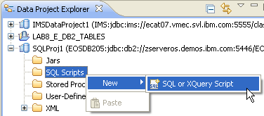
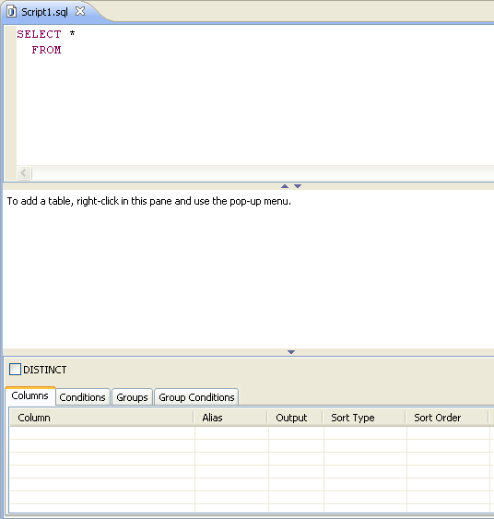
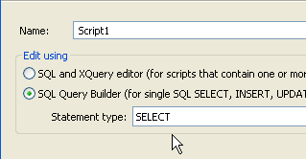
SQL Statement GUI-Development – continued
From the Explorer:
  Right-click over SQL Script and select:
    New > SQL or XQuery script
    Name the script
    Select the Statement type
  This will open a new SQL editor

Slide 39
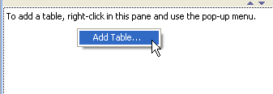
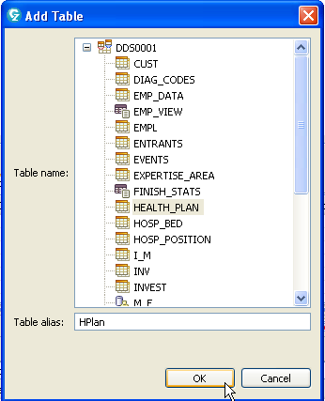

SQL Statement GUI-Development – continued
Using the editor you can follow the prompts and layout to create SQL statements graphically
Add a new table
From the list of columns select one or more columns to add

Slide 40



SQL Statement GUI-Development – continued
From the Conditions tab, add a WHERE clause
Note that you can:
  Select a column, Operator, Value, AND/OR from a drop-down list box
    Or you can type the statement portions (and the graphical view will synchronize)
  Right-click over the statement and select Run SQL to test
Note that you will definitely have to understand SQL to use this tool

Slide 41


Relative SQL Performance Benchmarks
You can use the facilities of the Data Perspective creatively, to estimate the effect of different SQL coding approaches on execution time
Steps:
  Using the SQL Script editor, code and run your statement
  Note the Query execution time in the Status tab
  Try different coding approaches
  Note the relative differences in Query execution time

Slide 42


Alternative Approach to Relative SQL Performance Benchmarks
You can use the facilities of the Data Perspective creatively, to benchmark different SQL designs. Steps:
  Create a series of SQL statements
    Sandwich each SQL design between a SELECT of the current timestamp (as shown)
    After you run your statement series use the timing data to determine the "relative" performance results of each design
Optionally – copy the Result rows to an external file for analysis and "safe keeping"
Expand Script Status Entry ➔

Slide 43

Copy/Paste an Existing SQL Statement - 1 of 2
You can use the SQL Scrapbook to test your COBOL/SQL statements out prior to testing them at the COBOL procedural logic level (note this saves both time and CPU resources)
Steps:
  From RDz, click back over to the z/OS Perspective (but do NOT close the Data Perspective)
  Open: cursravg.cbl
  Find the 100-DECLARE-CURSOR-RTN paragraph shown below
  Copy the SELECT… ➔ GROUP BY DEPT clauses as shown
 - You will test only the interactive SQL portion of your COBOL cursor declaration
Select
and
copy
this
Notes:
Notes:
Select → Group By constitutes the Interactive SQL portion of this statement

Slide 44

Copy/Paste an Existing SQL Statement - 2 of 2
From RDz, click back to the Data Perspective
If you still have your other SQL Script page open, select and delete the existing statement, then Paste in the copied SQL cursor code
Right-click and Run the SQL Statement and view results in the Data Output tab
 Note: As you did with the sample table contents, you can Right-click over the result rows, and save the result data to a file on your hard-drive. This can be VERY useful during SQL statement testing/debugging.
Notes:
Notes:
You can only run Interactive SQL Statements – that is, statements without Host Variables. You can usually replace host variables with apostrophe-contained literals:
Example:
select
COBOL.CUSTOMER.CUSTOMER_ID, COBOL.CUSTOMER.FIRST_NAME,
COBOL.CUSTOMER.LAST_NAME, COBOL.CUSTOMER.PASSWORD,
COBOL.CUSTOMER.PHONE, COBOL.CUSTOMER.EMAIL_ADDRESS,
COBOL.CUSTOMER.STREET, COBOL.CUSTOMER.APARTMENT,
COBOL.CUSTOMER.CITY, COBOL.CUSTOMER."STATE",
COBOL.CUSTOMER.POSTALCODE, COBOL.CUSTOMER.DIRECTIONS
from COBOL.CUSTOMER
where state = :stateIn
order by
COBOL.CUSTOMER.CUSTOMER_ID asc
Becomes….
select
COBOL.CUSTOMER.CUSTOMER_ID, COBOL.CUSTOMER.FIRST_NAME,
COBOL.CUSTOMER.LAST_NAME, COBOL.CUSTOMER.PASSWORD,
COBOL.CUSTOMER.PHONE, COBOL.CUSTOMER.EMAIL_ADDRESS,
COBOL.CUSTOMER.STREET, COBOL.CUSTOMER.APARTMENT,
COBOL.CUSTOMER.CITY, COBOL.CUSTOMER."STATE",
COBOL.CUSTOMER.POSTALCODE, COBOL.CUSTOMER.DIRECTIONS
from COBOL.CUSTOMER
where state = ‘NJ’
order by
COBOL.CUSTOMER.CUSTOMER_ID asc

Slide 45

Table Row Value Editing – 1 of 2
 Another very common requirement for SQL programming is to customize your test data. Rather than fussing with interactive SQL INSERT/UPDATE/DELETE statements using QMF or SPUFI, try this:
  From the Data Source Explorer
  Right-click over a table
  Select: Data > Edit
Notes:
Notes:

Slide 46

Table Row Value Editing – 2 of 2
The table editor allows you to:
  Modify (update) values
  Add (insert) new rows
  Delete Rows
  Set individual field values to null
  Select image files (for columns of type: Blob/Clob)
All values are saved (committed) or not (rolled-back) at once when you press Ctrl/S
€ $$$ ₤ - Consider the time, effort (and CPU cycles) saved by using this facility
 And note that using the Data Perspective you could easily combine (without leaving RDz): 1. Run a SQL Statement, 2. View SQL results, 3. Modify table data values in order to test different WHERE clause conditions, 4. Re-run the SQL Statement, etc.
Notes:
Notes:

Slide 47
RDz Workbench – Using the Data Source Explorer
Workshops -   
Notes:
This module will require approximately 30 minutes to complete:

Slide 48
 Data Perspective – Workshop Plan A – Using your own DB2 Objects
If you have your own DB2 connection, with the help of your DBA and/or Systems Programming staff do the following:
  Open the Data Perspective
  Connect to a DB2 database
  View some of the tables and their relationships through the Overview Diagram
  Show a table’s Sample Contents
  Code a few simple SQL statements (or copy/paste from a COBOL program) and run them in a SQL Scrapbook
  Create a simple new SQL statement using the statement builder
  Edit one of the DB2 tables you have update access to:
    Add a few new rows
    Update some values
    Delete one or two rows
    Save your changes – Ctrl/S
Other Workshop Options (using your own RDBMS):
  If you have DB2/UDB installed – either on your workstation or server, you can create the DB2 objects using the SQL/DDL in this Unit's Appendices
  If you have RAD installed, you may use a Derby database (Derby is an Open-Source version of DB2)
    Slides that explain how to use Derby are also in the Appendix
Notes:
Notes:

Slide 49
 Data Perspective – Workshop Plan B – Using IBM's DB2 Objects
If you have access to zServerOS – and DB2, you can do the following:
  Open the Data Perspective
  Connect to the zServerOS DB2 database
  View some of the tables and their relationships through the Overview Diagram
  Show a table’s Sample Contents
  Code a few simple SQL statements (or copy/paste from a COBOL program) and run them in a SQL Scrapbook
  Create a simple new SQL statement using the statement builder
  Edit one of the DB2 tables you have update access to:
    Add a few new rows
    Update some values
    Delete one or two rows
    Save your changes – Ctrl/S
Notes:
Notes:

Slide 50
 Workshop – Connecting to DB2 on zServerOS
On z/OS you will need to provide a few different pieces of information, in order to connect:
  Location:
    EOSDB205
  Host:
  zserveros.demos.ibm.com
  Port: 5446
  User name/Password:
  Your assigned UID/PWD
  Example:
    RTPOTnn
    <password>
Select: DB2 for z/OS as the database manager
Click Next >

Slide 51
 Workshop – Filtering Schemas and Tables
Recall:
  In the DB2 world on z/OS databases could easily contain:
    Tens of thousands of tables
    Thousands of Schemas
To simplify working on your projects filter the available DB2 objects
Un-check: □ Disable Filter
Enter: DDS0001
  In: ◙ Expression name

Slide 52


 Data Perspective Workshop – 1 of 6
When your connection create process finishes, you will be returned to the Data Perspective, where you now can:
  Expand:
    Schemas
      Synonyms
      Tables
        Table elements
      Views
  Explore and with the DB2 objects
    Open RESULTS
      Look at the various elements
Expand
Notes:
Notes:

Slide 53



 Data Perspective Workshop – 2 of 6
You can also work with a Table, View or Synonym's DDL:
Try the following with the CUST table:
  Extract table data to a comma delimited file on your workstation
  Generate the DDL for your table
    Be sure to:
      Browse and select one of your chapter folders
      Check the option to ☑ Open the DDL file for editing
*** If you are using your own training DB2 or UDB database:
3. Drop the table
4. Edit script1.sql
    Add a Schema that exists, to qualify the table name
    Add a ZIP column
    Select the Database Connection
    Run your new DDL to create a new version of the CUST table
Table – Name qualified with APP. schema
Notes:
Notes:

Slide 54



 Data Perspective Workshop – 3 of 6
*** If you are using your own DB2 tables or UDB:
  5. From Windows, open your extract file using Notepad
  6. Add Zip Code values for each row
  7. Save your edits
  8. From the Data Perspective, Load the new rows back into the CUST table
  9. Use the Table Editor to validate (and to learn about the Table Editor)
  Do at least the following:
  - Modify values
  - Add a new row
  - Delete a row
Other resource Data menu features:
on Tables and Views (and/or the Synonym)
Return All Rows and Sample Contents
  Both open a Result tab – Note that you can copy results by right-clicking over the Result tab and selecting an option from a Context Menu
Notes:
Notes: You probably don't have permission to load any of the IBM tables used in this course.

Slide 55


 Data Perspective Workshop – Testing SQL Statements – 4 of 6
From this slide – copy and all of the commented SQL statements in the Slide Notes
From the Data Source Explorer:
  Click New SQL Script
  Paste the SQL Statements in the Script1.sql tab
  Un-comment any# of statements
  Right-click over the Content Area
  Select: Run SQL
  In the Results, for multiple statements you can expand and select one at a time
  The Result1 tab shows data
  You will get some errors
Optional – try other Context Menu selections like (for the sub-selects) Format SQL
Statement Run Console Data Results
Notes:
-- ************** SQL Statements ***************** --
-- ************************************************************************* --
-- Different SELECT/FROM/WHERE clause combinations against dds0001.employee/dds0001.empl/PAY
-- ************************************************************************* --
--Select * from dds0001.empl where Perf between 2 and 5;
--Select * from dds0001.empl E, dds0001.Pay P
--Where E.nbr = p.nbr;
--SELECT * FROM dds0001.empl WHERE lname LIKE 'S%';
--SELECT DEPT FROM dds0001.employee;
--SELECT DISTINCT DEPT FROM dds0001.employee;
--SELECT * FROM dds0001.emplOYEE WHERE NBR BETWEEN 'AAAAAA' AND 'BBBBBBB'; -- #4. EBC COMPARE
--SELECT * FROM dds0001.emplOYEE WHERE NBR LIKE 'AAAAAA%' OR NBR LIKE 'BBBBBBB%'; -- #4. EBC COMPARE
--SELECT * FROM dds0001.employee WHERE NBR > 'AAAAAA'; -- #3. EBCDIC COMPARE
--SELECT DISTINCT NBR FROM dds0001.employee; -- #2. EBCDIC/ASCII ORDERING TO DISTINCT
--SELECT * FROM dds0001.employee ORDER BY NBR; -- #1. EBCDIC/ASCII ORDERING --SELECT * FROM dds0001.employee WHERE NBR > 'AAAAAA';
--SELECT * FROM dds0001.employee WHERE NBR LIKE '%S'; -- #5. LIKE WITH FIXED CHAR
--SELECT * FROM dds0001.employee WHERE NAME LIKE '%art';-- #5. LIKE WITH VARCHAR
--SELECT * FROM dds0001.employee WHERE DEPT IN ('EDUC','CONS '); -- #7. IN CLAUSE
--SELECT * FROM dds0001.employee WHERE DEPT NOT IN ('EDUC','CONS '); -- #8. NOT IN
--SELECT * FROM dds0001.employee WHERE NBR = 'AAAAAAAA '; -- #9.STRING PAD TEST
--SELECT * FROM dds0001.employee WHERE NAME = 'Jonathan Sayles '; -- #10. STRING PAD
--Select * from dds0001.empl E, dds0001.Pay P;
--SELECT * FROM dds0001.empl E, dds0001.pay PA, dds0001.proj PR
-- WHERE E.NBR = PA.NBR AND E.proj = PR.NBR; --#11.TABLE JOI N
--SELECT * FROM dds0001.employee E WHERE PERF = proj; -- #14. COMPARE COLUMNS
--SELECT * FROM dds0001.employee WHERE proj IS NULL; -- #16. NULL TEST
--SELECT * FROM dds0001.employee WHERE proj IS NOT NULL; -- #17. NOT NULL TEST
-- ******************************* --
-- ***** SQL Column Functions **** --
-- ******************************* --
--SELECT COUNT(*) FROM dds0001.employee; -- #18. COUNT FUNCTION
--SELECT COUNT(*) FROM dds0001.employee WHERE NBR > 'AAAAAAAA'; -- #19. EBCDIC PROBLEM
--SELECT MIN(NBR), MAX(NBR), AVG(PERF)
-- FROM dds0001.employee; -- #20. MIN/MAX/AVG FUNCTIONS
-- SELECT MIN(NBR), MAX(NBR), AVG(PERF)
-- FROM dds0001.employee WHERE NBR > 'AAAAAAAA'; -- #21. EBCDIC PROBLEM
-- CREATE VIEW dds0001.employee_STATS (MAX_PERF, MIN_PERF, AVG_PERF) -- #22. VIEW
-- AS SELECT MAX(PERF), MIN(PERF), AVG(PERF) FROM dds0001.employee; -- W/FUNCS
-- SELECT SUM(AVG_PERF), AVG(AVG_PERF), COUNT(DISTINCT AVG_PERF)FROM dds0001.employee_STATS; -- #23. FUNCTION ON FUNCTION
--SELECT COUNT(DISTINCT PERF)
-- FROM dds0001.employee; -- #24a. ONE COUNT DISTINCT (ALLOWED)
--SELECT COUNT(DISTINCT PERF), COUNT(DISTINCT proj)
-- FROM dds0001.employee; -- #24b. TWO COUNT DISTINCTS (NOT ALLOWED)
--SELECT PERF * 10000 FROM dds0001.employee; --#25. POSSIBLE ARITHMETIC OVERFLOW IN COBOL
-- SELECT SUM(PERF * 10000) FROM dds0001.employee; --#26. ARITHMETIC OVERFLOW IN COBOL
-- SELECT DEPT, MIN(NBR), MAX(NBR), AVG(PERF)
-- FROM dds0001.employee GROUP BY DEPT; -- #27.GROUP BY WITH STATS
-- SELECT DEPT FROM dds0001.employee GROUP BY DEPT HAVING COUNT(*) > 1; -- #28.HAVING
--SELECT DEPT FROM dds0001.employee GROUP BY DEPT HAVING AVG(PERF) > 2;-- #29.HAVING
--SELECT DEPT FROM dds0001.employee GROUP BY DEPT HAVING DEPT = 'EDUC'; -- #30.HAVING
-- ******************************** --
--- ***** SQL Scalar Function ****** --
-- ******************************** --
--SELECT NAME || ' THIS IS A NAME' FROM dds0001.employee; -- #34. CONCATENATION
--SELECT VALUE(PERF,0) FROM dds0001.employee; -- #35. VALUE FUNCTION (zero substituted for NULL)
--SELECT SUBSTR(NAME,1,1) FROM dds0001.employee; -- #36. SUBSTR
--SELECT CHAR(HIREDTE,EUR) FROM dds0001.employee; -- #37. CHAR - works in DB2 (not Derby)
--SELECT DIGITS(PERF), DIGITS(RATE) FROM dds0001.employee E, dds0001.pay P
-- WHERE E.NBR = P.NBR; -- #38. DIGITS SMALLINT AND DECIMAL -- works in DB2 (not Derby)
--SELECT FLOAT(PERF) FROM dds0001.employee; -- #39. FLOATING POINT -- works in DB2 (not Derby)
--SELECT HEX(HIREDTE) FROM dds0001.employee; -- #40. INTERNALLY FORMATTED DATE -- works in DB2 (not Derby)
--SELECT HOUR(SHIFT) FROM dds0001.employee; -- #41. HOUR
--SELECT YEAR(HIREDTE) FROM dds0001.employee; -- #42. YEAR
--SELECT MONTH(HIREDTE) FROM dds0001.employee; -- #43. MONTH
--SELECT DAY(HIREDTE) FROM dds0001.employee; -- #44. DAY
--SELECT DAYS(HIREDTE) FROM dds0001.employee; -- #45. DAYS -- works in DB2 (not Derby)
--SELECT HIREDTE + 10000 YEARS FROM dds0001.employee; --#46. YEAR OVERFLOW -- works in DB2 (not Derby)
--SELECT HIREDTE + 1 YEAR FROM dds0001.employee; -- #47. DATE ROLL-AROUND -- works in DB2 (not Derby)
--SELECT HIREDTE + 1 MONTH FROM dds0001.employee; -- #48. DATE ROLL-AROUND-- works in DB2 (not Derby)
--SELECT INTEGER(RATE) FROM dds0001.pay; -- #49. INTEGER FUNCTION
--SELECT LENGTH(NAME) FROM dds0001.employee; -- #50. LENGTH FUNCTION
--SELECT SECOND(Shift) FROM dds0001.employee; -- #52. SECOND
--SELECT MINUTE(Shift) FROM dds0001.employee; -- #53. MINUTE
-- ******************************* --
--- ********* Subselects ********* --
-- ******************************* --
--SELECT * FROM dds0001.empl WHERE NBR IN (SELECT NBR FROM dds0001.pay ); -- #54.SUBSELECT
--SELECT * FROM dds0001.empl WHERE NBR NOT IN (SELECT NBR FROM dds0001.pay);-- #55. O/JOIN
--SELECT * FROM dds0001.empl E WHERE EXISTS
-- (SELECT * FROM dds0001.pay P WHERE E.NBR = P.NBR); -- #56. EXISTS FUNCTION
--SELECT * FROM dds0001.empl E WHERE NOT EXISTS
-- (SELECT * FROM dds0001.pay P WHERE E.NBR = P.NBR); -- #57. NOT EXISTS (OUTER JOIN)
--SELECT * FROM dds0001.empl WHERE DEPT = 'ACC' AND PERF > ALL
-- (SELECT PERF FROM dds0001.empl WHERE DEPT = 'R&D'); -- #58. GREATER ALL
--SELECT * FROM dds0001.empl WHERE PERF > ALL
-- (SELECT PERF FROM dds0001.empl WHERE DEPT = 'RAD'); -- #59. GREATER ALL ANOMALY (no RAD DEPT)
-- SELECT * FROM dds0001.empl WHERE PERF >
-- (SELECT MAX(PERF) FROM dds0001.empl WHERE DEPT = 'RAD'); --#60. EQUIV. TO 59 - but no rows returned
--SELECT * FROM dds0001.employee WHERE PERF >
-- (SELECT PERF FROM dds0001.employee WHERE NBR = 'AAAAAAAA'); -- #61 SMALLEST PERF
--SELECT * FROM dds0001.employee WHERE PERF >
-- (SELECT PERF FROM dds0001.employee WHERE NBR = 'AAA AAA'); -- #62. NON-EXISTENT dds0001.emplOYEE
-- SELECT * FROM dds0001.employee WHERE PERF >
-- (SELECT PERF FROM dds0001.employee WHERE NBR = 'ZZZZZZZZ'); -- #63. EMP WITH MAX
-- SELECT * FROM dds0001.employee WHERE PERF >
-- (SELECT PERF FROM dds0001.employee WHERE NBR = 'BBBBBBBB'); -- #64. EMP WITH NULL PERF
--SELECT AVG(proj), SUM(proj)/COUNT(*), AVG(proj * 1.0),
-- SUM(proj * 1.0) / COUNT(*) FROM dds0001.employee; -- #65. NULL TEST - Throws warnings
--SELECT * FROM dds0001.employee WHERE PERF > SOME
-- (SELECT PERF FROM dds0001.employee WHERE DEPT = 'EDUC'); -- #66. SOME SPECIFIER
--SELECT * FROM dds0001.employee WHERE PERF > SOME
-- (SELECT PERF FROM dds0001.employee WHERE DEPT = 'R%D'); --#67.SOME NO R%D - anomaly
--SELECT * FROM dds0001.employee WHERE PERF >
-- (SELECT PERF + 1 FROM dds0001.employee WHERE DEPT = 'FIN'); --#75.SUBS. EXPR.
-- ******************************** --
--- ******** SQL Comparisons ******* --
-- ******************************** --
--SELECT * FROM dds0001.employee WHERE NAME LIKE 'O+%XXX' ESCAPE '+';--#68 LIKE/ESCAPE - not finished
--SELECT * FROM dds0001.employee WHERE PERF + 2 IS NULL; --#69 EXPRESSION IS NULL
--SELECT * FROM dds0001.employee WHERE PERF != 2 ; --#70 COMPARISON TEST
--SELECT * FROM dds0001.employee WHERE PERF >= 2 ; --#71 COMPARISON TEST
--SELECT * FROM dds0001.employee WHERE PROJ + 1 IS NULL; --#76 EXPR. NULL
--SELECT 'TRUE' FROM dds0001.employee HAVING AVG(PERF) > 2; --#76 Is the average of all Perf > 8
--SELECT AVG(DECIMAL(PERF,4,2) ) FROM dds0001.employee; -- #81. AVG(DECIMAL)
--SELECT * FROM dds0001.employee ORDER BY PERF; -- #82. CHECK NULL COLLATING SEQ.
--seLECT DATE('1992-01-01') - 1 MONTH FROM dds0001.employee;-- #83. CHECK DATE MATH1
--seLECT 1 MONTH + DATE('1992-01-01') FROM dds0001.employee;-- #84. CHECK DATE MATH2
--seLECT '00010101' + HIREDTE FROM dds0001.employee;-- #86. CHECK DATE MATH3
-- SELECT (VALUE(PERF,0)/0) FROM dds0001.employee;-- #87. EXTEND. VALUE TEST (EXPECT NULL)
--SELECT * FROM dds0001.employee WHERE NAME LIKE '%W+%%' ESCAPE '+';
-- ************************************** --
--- *** UNION/ALL/INTERSECT/EXCEPT ******* --
-- ************************************** --
-- SELECT NBR,NAME FROM dds0001.employee
-- UNION
-- SELECT NBR, 'Payroll' FROM dds0001.pay; -- #31. UNION WITH MIXED DATATYPES
-- SELECT NBR,NAME, PERF FROM dds0001.employee WHERE DEPT = 'ACC'
-- UNION ALL
-- SELECT NBR,NAME, PERF FROM dds0001.employee WHERE DEPT IN ('EDUC'); -- #32.UNION ALL
-- SELECT PERF FROM dds0001.employee
-- UNION
-- SELECT RATE FROM dds0001.pay; -- #33. UNION WITH MIXED NUMERIC DATATYPES (perf is int, rate is dec)
-- SELECT DEPT FROM dds0001.employee group by dept having avg(PERF) > 1 --#74 INTERSECT TEST
-- except -- list DEPT from different
-- SeLECT DEPT FROM dds0001.empl group by dept having avg(PERF) > 1 ; -- tables with dds0001.emplyoyees do NOT avg perf > 1
-- SELECT DEPT FROM dds0001.employee group by dept having avg(PERF) > 1 --#74 INTERSECT TEST
-- Intersect -- list DEPT from different
-- SeLECT DEPT FROM dds0001.empl group by dept having avg(PERF) > 1 ; -- tables with dds0001.emplyoyees avg perf > 1

Slide 56

 Testing Embedded SQL Using the Data Perspective – 5 of 6
From this slide's Notes, copy the COBOL program (name: CURSRAVG)
From the z/OS Perspective:
  Create a new file under the \cobol\ folder in your project
  Paste the statements into the file and Save (do not Syntax Check)
  Select and Copy the Interactive portion of the SQL SELECT statement in this paragraph – minus all of the embedded COBOL syntax (shown below in the screen capture)
Notes:
IDENTIFICATION DIVISION.
PROGRAM-ID. CURSRAVG.
*REMARKS. THIS PROGRAM JOINS TABLES, GROUPS DATA BY DEPT,
* AND DISPLAYS THE AVERAGE, MAXIMUM AND MINIMUM
* HOURS, AND PERFORMANCE EVALUATION BY DEPT.
*
ENVIRONMENT DIVISION.
CONFIGURATION SECTION.
SOURCE-COMPUTER. IBM-370.
OBJECT-COMPUTER. IBM-370.
DATA DIVISION.
WORKING-STORAGE SECTION.
* CODE THE NECESSARY DB2 INCLUDE STATEMENTS HERE
01 WS-KTRS-SWITCHES.
05 ROW-KTR PIC S9(03) COMP-3 VALUE +0.
* MODIFY THE TABLE-ROW PICTURE CLAUSES FOR THE HOST
* PROGRAM VARIABLES - LOOK AT THE TABLE/COLUMN DEFINITIONS
* IN YOUR MANUAL (APPENDIX A FROM THE SQL PORTION)
* AND THE SQL TO COBOL DATATYPES IN CHAPTER 3
*
* YOU WILL NEED TWO NULL INDICATORS - BASED ON POTENTIAL NULL
* VALUES IN THE EMPL TABLE; ONE FOR DEPT, AND ONE FOR PERF.
* QUESTION . . . WHY DON'T YOU NEED A DIFFERENT NULL VALUE
* FOR MIN, MAX AND AVG(PERF) ???
EXEC SQL INCLUDE SQLCA END-EXEC.
01 TABLE-ROW.
05 DEPT-TBL PIC X(3).
05 PERF-TBL-AVG PIC S9(05)V99 COMP-3.
05 PERF-TBL-MIN PIC S9(04) COMP.
05 PERF-TBL-MAX PIC S9(04) COMP.
05 HOURS-TBL-AVG PIC S9(05)V99 COMP-3.
05 HOURS-TBL-MAX PIC S9(05)V99 COMP-3.
05 HOURS-TBL-MIN PIC S9(05)V99 COMP-3.
01 OUTPUT-ROW.
05 FILLER PIC X(01) VALUE SPACES.
05 DEPT-RPT PIC X(03).
05 FILLER PIC X(03) VALUE SPACES.
05 PERF-RPT-AVG PIC Z(03).99.
05 FILLER PIC X(01) VALUE SPACES.
05 PERF-RPT-MIN PIC Z(03).99.
05 FILLER PIC X(01) VALUE SPACES.
05 PERF-RPT-MAX PIC Z(03).99.
05 FILLER PIC X(03) VALUE SPACES.
05 HOURS-RPT-AVG PIC Z(03).99.
05 FILLER PIC X(03) VALUE SPACES.
05 HOURS-RPT-MAX PIC Z(03).99.
05 FILLER PIC X(03) VALUE SPACES.
05 HOURS-RPT-MIN PIC Z(03).99.
01 NULL-GROUP.
05 DEPT-NULL PIC S9(04) COMP.
05 PERF-NULL PIC S9(04) COMP.
01 ROW-MSG.
05 FILLER PIC X(24)
VALUE '* * * ROWS READ -->'.
05 ROW-STAT PIC Z99.
* ERROR MSG AREA FOR CALLS TO DSNTIAR - WHICH DECODES YOUR
* SQL RETURN CODES (SQLCODE) FOR YOU.
01 ERROR-MSG.
05 ERROR-LEN PIC S9(04) COMP VALUE +960.
05 ERROR-TEXT PIC X(120) OCCURS 8 TIMES
INDEXED BY ERR-IDX.
01 ERROR-TEXT-LEN PIC S9(09) COMP VALUE +120.
PROCEDURE DIVISION.
000-SETUP-ERROR-TRAP-RTN.
* THIS PORTION OF THE PROGRAM ACTIVATES THE SQL ERROR TRAPPING
* FACILITIES. AT PRE-COMPILE TIME, THE DB2 PRE-COMPILER
* GENERATES COBOL INSTRUCTIONS TO INTERROGATE THE SQLCODE
* (RETURN CODE) FROM EACH CALL. IF A SQLERROR CONDITION IS
* DETECTED (NEGATIVE RETURN CODE), EXECUTION WILL BRANCH TO THE
* 999-ERROR-TRAP-RTN TO DISPLAY AN APPROPRIATE ERROR MSG.
* SET UP YOUR ERROR HANDLING ROUTINES
000-MAINLINE-RTN.
* THE MAINLINE CONTAINS THE DRIVER CODE TO PERFORM OUR DATA
* BASE ACCESS AND DISPLAY ROUTINES.
PERFORM 100-DECLARE-CURSOR-RTN THRU 100-EXIT.
PERFORM 150-OPEN-CURSOR-RTN THRU 150-EXIT.
PERFORM 200-FETCH-RTN THRU 200-EXIT
UNTIL SQLCODE = +100.
PERFORM 300-CLOSE-CURSOR-RTN THRU 300-EXIT.
PERFORM 350-TERMINATE-RTN THRU 350-EXIT.
MOVE ZERO TO RETURN-CODE.
GOBACK.
000-EXIT.
EXIT.
100-DECLARE-CURSOR-RTN.
* THIS STATEMENT CREATES AN "ACTIVE SET", A GROUP OF ROWS
* THAT WOULD BE THE OUTPUT FROM THE EXECUTION OF THE STATEMENT
* IF YOU EXECUTED IT INTERACTIVELY.
* = = = > CODE THE SQL STATEMENT TO JOIN THE EMPL AND PAY TABLES
* = = = > GROUP THEM BE EMPL.DEPT AND DISPLAY THE DEPT AND:
* = = = > AVERAGE, MINIMUM AND MAXIMUM - HOURS AND PERF BY DEPT
EXEC SQL
DECLARE C1 CURSOR FOR
*==> COPY CURSORD1.SQL IN HERE...IF YOU GO THIS IN THE ISQL EXERCISE
*==> COPY CURSORX1.CPY IN HERE...IF YOU MISSED THIS IN THE ISQL
* EXERCISE
END-EXEC.
*--- THE CODE LISTED BELOW IS THE EXPECTED RESULTS FROM CURSORD1 OR
*--- CURSORX1.
* SELECT DEPT, MIN(PERF), MAX(PERF), AVG(PERF),
* MIN(HOURS), MAX(HOURS), AVG(HOURS)
* FROM DDS0001.EMPL E, DDS0001.PAY P
* WHERE E.NBR = P.NBR
* GROUP BY DEPT
*
100-EXIT.
EXIT.
150-OPEN-CURSOR-RTN.
* THIS STATEMENT OPENS THE "ACTIVE SET" IN PREPARATION OF
* ROW FETCH PROCESSING.
EXEC SQL OPEN C1
END-EXEC.
150-EXIT.
EXIT.
200-FETCH-RTN.
* THIS PARAGRAPH SETS UP THE SQL PARAMETERS, PERFORMS THE
* PARAGRAPH TO FETCH THE ROW, AND DISPLAYS THE RESULTS.
* ----> HINT <--- USE ISPF EXCLUDE (XX) OR BLOCK COPY
* FROM YOUR CURSOR DECLARE STATEMENT TO VERIFY PROPER
* SELECTED TABLE/COLUMN TO FETCHED HOST-VARIABLE MATCHING
PERFORM 250-FETCH-A-ROW THRU 250-EXIT.
IF SQLCODE = ZERO
THEN
MOVE DEPT-TBL TO DEPT-RPT
MOVE PERF-TBL-AVG TO PERF-RPT-AVG
MOVE PERF-TBL-MIN TO PERF-RPT-MIN
MOVE PERF-TBL-MAX TO PERF-RPT-MAX
MOVE HOURS-TBL-AVG TO HOURS-RPT-AVG
MOVE HOURS-TBL-MAX TO HOURS-RPT-MAX
MOVE HOURS-TBL-MIN TO HOURS-RPT-MIN
DISPLAY OUTPUT-ROW
ELSE
DISPLAY '*** END - OF - DATA ***'.
200-EXIT.
EXIT.
250-FETCH-A-ROW.
* THIS PARAGRAPH FETCHES A ROW FROM THE EMPL AND PAY TABLES
* AND MOVES SPECIFIC DATA FIELDS INTO THE AVG, MIN AND MAX FIELDS
EXEC SQL FETCH C1 INTO
:DEPT-TBL:DEPT-NULL,
:PERF-TBL-MIN:PERF-NULL,
:PERF-TBL-MAX:PERF-NULL,
:PERF-TBL-AVG:PERF-NULL,
:HOURS-TBL-MIN,
:HOURS-TBL-MAX,
:HOURS-TBL-AVG,
END-EXEC.
* COMPLETE THE LOGIC BELOW TO HANDLE THE NULL CONDITION FOR YOUR
* REPORT - WHY IS THIS NECESSARY?
IF DEPT-NULL < 0
THEN
MOVE 'N/A' TO DEPT-TBL.
IF PERF-NULL < 0
THEN
MOVE 0 TO PERF-TBL-MIN
MOVE 0 TO PERF-TBL-MAX
MOVE 0 TO PERF-TBL-AVG.
250-EXIT.
EXIT.
300-CLOSE-CURSOR-RTN.
* THIS STATEMENT CLOSES THE "ACTIVE SET"
EXEC SQL CLOSE C1 END-EXEC.
300-EXIT.
EXIT.
350-TERMINATE-RTN.
MOVE ROW-KTR TO ROW-STAT.
DISPLAY ROW-MSG.
350-EXIT.
EXIT.
999-ERROR-TRAP-RTN.
************************************************************
* ERROR TRAPPING ROUTINE FOR NEGATIVE SQLCODES *
************************************************************
DISPLAY '**** WE HAVE A SERIOUS PROBLEM HERE *****'.
DISPLAY '999-ERROR-TRAP-RTN '.
MULTIPLY SQLCODE BY -1 GIVING SQLCODE.
DISPLAY 'SQLCODE ==> ' SQLCODE.
DISPLAY SQLCA.
DISPLAY SQLERRM.
EXEC SQL WHENEVER SQLERROR CONTINUE END-EXEC.
EXEC SQL ROLLBACK WORK END-EXEC.
GOBACK.
999-EXIT.
EXIT.

Slide 57

 Testing Embedded SQL Using the Data Perspective – 6 of 6
Swap back over to the Data Perspective
Either reuse your existing SQL Script, or create a New SQL Script using the EGLDerbyR7 connection
Paste the copied Cursor Declare inside the editor
Right-click and select Run SQL
Verify the results
Note – NULL group… (was that something you expected)?

Slide 58

Topic Summary
Now that you have completed this topic, you should be able to:
  Launch the Data Perspective
  Connect to a Data Source
  Use the Data Source Explorer to:
    View tables and relationships
    View sample table rows and values
    Edit (create, update, delete) row values
    Test interactive SQL
    Code/Build SQL statements
    Generate Table DDL
Summary

Slide 59
RDz Workbench – Using the Data Source Explorer
Appendices
- Connecting to DB2/UDB
- Connecting to a Derby database
Notes:
This module will require approximately 30 minutes to complete:

Slide 60

 Data Perspective Workshop – DB2/UDB
From this URL: http://www.ibm.com/developerworks/downloads/im/udb/
  1. Download and install UDB on your workstation
  2. From RDz and the Data Perspective
    Create a new connection to the UDB SAMPLE Database
      See next slide for help with this
    Select and copy the SQL statements in the slide Notes
    Create a new SQL Script to the UDB SAMPLE Database
    Run the script against the SAMPLE Database
    Refresh the SAMPLE Database in the Explorer
Notes:
-- THESE ARE THE DATA DEFINITION LANGUAGE STATEMEMTS TO DEFINE AND
-- LOAD THE TABLES USED IN THE SYSTEMS GROUP DB2 COURSES.
-- THE TABLE NAMES ARE:
-- MOV
-- CUST
-- INV
-- I_M
-- EMPL
-- PAY
-- PROJ
-- MOOSUP_500
--
-- THE DDL STATEMENTS TO GENERATE THESE TABLES CONSIST OF CREATE
-- TABLE STATEMENTS, AND CORRESPONDING FORMAT ONE
-- INSERT STATEMENTS. THE TABLE CREATE STATEMENTS NEED TO BE EDITED
-- SO THAT THE CORRECT DATABASE (AND/OR) TABLESPACE CAN BE USED TO
-- HOLD THEM. ONE COPY OF THE TABLES SHOULD BE CREATED
-- ON THE INSTRUCTOR'S TSO ID.
--
-- *** YOU CAN CREATE THE STUDENT TABLES ONE OF TWO WAYS:
--
-- 1) AS A DBADM DUPLICATE THE STATEMENTS IN THIS FILE, NAMING THE
-- TABLES WITH THE STUDENTS TSO-ID AS THE HIGH-LEVEL QUALIFIER
-- 2) LET THE STUDENTS COPY THE FILE AND CREATE THE TABLES THEMSELVES
-- USING SPUFI DURING CLASS
--
-- THE ISPF EDIT COMMAND TO CHANGE THE DATABASE SHOULD LOOK LIKE THIS:
-- C'SAMPLE' 'REALDB' ALL
--
-- *******************************************************************
-- * I M P O R T A N T N O T E F O R S E T U P *
-- *******************************************************************
-- * *
-- * IF YOU HAVE TIME, COULD YOU PLEASE CREATE A PLAN_TABLE FOR *
-- * ALL STUDENTS? THE PLAN_TABLE SHOULD BE AT THE RELEASE LEVEL *
-- * OF THE DB2 SYSTEM THE STUDENTS WILL BE WORKING ON. THANK YOU. *
-- * *
-- *******************************************************************
--
-- THE CREATE TABLE STATEMENTS FOR THE MOVIE TABLE.
--
--
CREATE TABLE MOV (NBR SMALLINT,
TITLE CHAR(20),
TYPE CHAR(6),
RATING CHAR(4),
STAR CHAR(10),
QTY SMALLINT,
PRICE DECIMAL(5,2) )
IN DATABASE SAMPLE;
--
-- THE INSERT STATEMENTS FOR THE MOVIE TABLE.
--
INSERT INTO MOV
VALUES (1,'GONE W]TH THE WIND','DRAMA',NULL,'GABLE',4,39.95);
INSERT INTO MOV
VALUES (2,'FRIDAY THE 13TH','HORROR','R','JASON',2,69.95);
INSERT INTO MOV
VALUES (3,'TOP GUN','DRAMA','PG','CRUISE',7,49.95);
INSERT INTO MOV
VALUES (4,'SPLASH','COMEDY','PG13','HANKS',3,29.95);
INSERT INTO MOV
VALUES (5,'101 DALMATIONS','COMEDY','G',NULL,3,59.95);
INSERT INTO MOV
VALUES (6,'BODY HEAT','DRAMA','R','TURNER',3,19.95);
INSERT INTO MOV
VALUES (7,'RISKY BUSINESS','COMEDY','R','CRUISE',2,44.55);
INSERT INTO MOV
VALUES (8,'COCOON','SCIFI','PG','AMECHE',2,NULL);
INSERT INTO MOV
VALUES (9,'CROCIDILE DUNDEE','COMEDY','PG13','HARRIS',2,69.95);
INSERT INTO MOV
VALUES (10,'TOOTSIE','COMEDY','PG','HOFFMAN',1,29.95);
--
--
-- THE CREATE TABLE STATEMENTS FOR THE INVOICE TABLE
--
CREATE TABLE INV (NBR SMALLINT,
CUSTID CHAR(2),
TOT DECIMAL(5,2),
RENT INTEGER,
RETURN INTEGER)
IN DATABASE SAMPLE;
--
-- THE INSERT STATEMENTS FOR THE INVOICE TABLE
--
INSERT INTO INV
VALUES (1,'01',9.55,87055,NULL);
INSERT INTO INV
VALUES (2,'02',13.55,87030,NULL);
INSERT INTO INV
VALUES (3,'02',21.01,87041,87042);
INSERT INTO INV
VALUES (4,'01',11.25,87042,87072);
INSERT INTO INV
VALUES (5,'03',12.55,87045,87051);
INSERT INTO INV
VALUES (6,'02',9.75,87047,87051);
INSERT INTO INV
VALUES (7,'04',10.35,86355,NULL);
INSERT INTO INV
VALUES (8,'04',12.55,87051,87053);
INSERT INTO INV
VALUES (9,'05',10.35,87052,NULL);
INSERT INTO INV
VALUES (10,'02',7.55,87030,87060);
--
--
-- THE CREATE TABLE STATEMENTS FOR THE CUSTOMER TABLE
--
CREATE TABLE CUST (ID CHAR(2),
LNAME CHAR(12),
FNAME CHAR(6),
CITY CHAR(15),
ST CHAR(2) )
IN DATABASE SAMPLE;
--
-- THE INSERT STATEMENTS FOR THE CUSTOMER TABLE
--
INSERT INTO CUST
VALUES ('01','DANGERFIELD','RODNEY','HARTFORD','CT');
INSERT INTO CUST
VALUES ('02','FIELD','SALLY','FRANKLIN','NY');
INSERT INTO CUST
VALUES ('03','NICHOLSON','JACK','HARTFORD','CA');
INSERT INTO CUST
VALUES ('04','MURRAY','FRED','BOZRAH','CT');
INSERT INTO CUST
VALUES ('05','MADDEN','JOHN','BRATTLEBORO','VT');
INSERT INTO CUST
VALUES ('06','WEST','MAE','PARK PLACE','CA');
INSERT INTO CUST
VALUES ('07','WOODWARD','JOANNE','GETTYSBURG','PA');
INSERT INTO CUST
VALUES ('08','ROGERS','ROY','HAPPY TRAILS','TX');
INSERT INTO CUST
VALUES ('09','RINGWALD','MOLLY','PINKSVILLE','CA');
INSERT INTO CUST
VALUES ('10','ROGERS','FRED','PARK PLACE','CA');
--
--
-- THE CREATE TABLE STATEMENTS FOR THE INVOICE_MOVIE TABLE
--
CREATE TABLE I_M (I_NBR SMALLINT,
M_NBR SMALLINT)
IN DATABASE SAMPLE;
--
-- THE INSERT STATEMENTS FOR THE CUSTOMER TABLE
--
INSERT INTO I_M
VALUES (1,4);
INSERT INTO I_M
VALUES (1,5);
INSERT INTO I_M
VALUES (2,3);
INSERT INTO I_M
VALUES (3,1);
INSERT INTO I_M
VALUES (3,10);
INSERT INTO I_M
VALUES (4,6);
INSERT INTO I_M
VALUES (4,3);
INSERT INTO I_M
VALUES (4,5);
INSERT INTO I_M
VALUES (4,1);
INSERT INTO I_M
VALUES (5,1);
INSERT INTO I_M
VALUES (5,7);
INSERT INTO I_M
VALUES (7,1);
INSERT INTO I_M
VALUES (7,3);
INSERT INTO I_M
VALUES (7,5);
INSERT INTO I_M
VALUES (8,4);
INSERT INTO I_M
VALUES (8,7);
INSERT INTO I_M
VALUES (9,9);
INSERT INTO I_M
VALUES (9,2);
INSERT INTO I_M
VALUES (10,4);
INSERT INTO I_M
VALUES (10,4);
INSERT INTO I_M
VALUES (10,1);
INSERT INTO I_M
VALUES (10,5);
INSERT INTO I_M
VALUES (10,4);
--
--
-- THE CREATE TABLE STATEMENTS FOR THE EMPLOYEE TABLE
--
CREATE TABLE EMPL (NBR CHAR(2),
LNAME CHAR(10),
FNAME CHAR(8),
DOB INTEGER,
HIREDTE INTEGER,
PERF SMALLINT,
JOB CHAR(4),
DEPT CHAR(3),
PROJ CHAR(2) )
IN DATABASE SAMPLE;
--
-- THE INSERT STATEMENTS FOR THE EMPLOYEE TABLE
--
INSERT INTO EMPL
VALUES ('01','LOWE','ROB',53012,85012,4,'PROG','FIN','01');
INSERT INTO EMPL
VALUES ('02','SHIELD','BROOKE',59131,87001,3,'MAN','MKT','01');
INSERT INTO EMPL
VALUES ('03','MOORE','ROGER',48111,86002,1,'DIR','MKT','04');
INSERT INTO EMPL
VALUES ('04','EASTWOOD','CLINT',41091,60120,3,'PROG','FIN','03');
INSERT INTO EMPL
VALUES ('05','MOSTEL','ZERO',21365,84211,NULL,'PRES',NULL,NULL);
INSERT INTO EMPL
VALUES ('06','BURNS','GEORGE',11178,49001,2,'SYS','FIN','01');
INSERT INTO EMPL
VALUES ('07','O''NEIL','RYAN',42189,60121,3,'DIR','ACC','05');
INSERT INTO EMPL
VALUES ('08','MARVIN','LEE',32187,51876,2,'VP','ACC','02');
INSERT INTO EMPL
VALUES ('09','LANCASTER','BURT',41091,79092,1,'MAN','R&D','02');
INSERT INTO EMPL
VALUES ('10','BLAIR','LINDA',54013,85012,1,'PROG','MKT',NULL);
--
--
-- THE CREATE TABLE STATEMENTS FOR THE PROJECT TABLE
--
CREATE TABLE PROJ (NBR CHAR(2),
NAME CHAR(10),
DEPT CHAR(3),
MAJPROJ CHAR(2) )
IN DATABASE SAMPLE;
--
-- THE INSERT STATEMENTS FOR THE PROJECT TABLE
--
INSERT INTO PROJ
VALUES ('01','PHASERS','MKT',NULL);
INSERT INTO PROJ
VALUES ('05','SYSTEM X','MKT','03');
INSERT INTO PROJ
VALUES ('03','SYSTEM R','FIN',NULL);
INSERT INTO PROJ
VALUES ('04','LASERS','ACC','01');
INSERT INTO PROJ
VALUES ('02','R*','FIN','03');
INSERT INTO PROJ
VALUES ('06','NEW PROJ','R&D','02');
--
--
-- THE CREATE TABLE STATEMENTS FOR THE PAYROLL TABLE
--
CREATE TABLE PAY (NBR CHAR(2),
HOURS DECIMAL(5,2),
RATE DECIMAL(5,2),
DED DECIMAL(5,2),
YTD DECIMAL(7,2) )
IN DATABASE SAMPLE;
--
-- THE INSERT TABLE STATEMENTS FOR THE PAYROLL TABLE
--
INSERT INTO PAY
VALUES ('01',8.89,43,128.78,11890.66);
INSERT INTO PAY
VALUES ('02',13.23,40,204.45,15840.78);
INSERT INTO PAY
VALUES ('03',6.11,49,94.76,11890.66);
INSERT INTO PAY
VALUES ('04',26.75,45,132.58,17605.66);
INSERT INTO PAY
VALUES ('05',67.82,37,394.69,79990.99);
INSERT INTO PAY
VALUES ('06',32.45,32,121.99,53421.23);
INSERT INTO PAY
VALUES ('07',26.75,49,101.56,32758.11);
INSERT INTO PAY
VALUES ('08',15.99,52,327.98,67870.01);
INSERT INTO PAY
VALUES ('09',43.59,24,0,28090.91);
INSERT INTO PAY
VALUES ('10',32.41,52,112.78,27000.01);
--
-- CREATE TABLE STATEMENT FOR MOOSUP_500 TABLE
--
CREATE TABLE MOOSUP_500
( ENTRANT SMALLINT,
CAR CHAR(10),
DRIVER VARCHAR(16),
PRICE DEC(7,2),
MILEAGE INTEGER,
PURCHASE DATE,
QUAL_TIM TIME )
IN DATABASE SAMPLE;
INSERT INTO MOOSUP_500 VALUES
(1,'LINCOLN','MARIO SPAGHETTI',3400.88,5400,'1987-01-01',
'01.14.39');
INSERT INTO MOOSUP_500 VALUES
(2,'SEAHAWK','MRS. PAUL',1940.25,2100,'1984-05-29',
'07.23.51');
INSERT INTO MOOSUP_500 VALUES
(3,'300 ZX','PAUL NEWMAN',189.99,12788,'1988-05-22',
'00.54.33');
INSERT INTO MOOSUP_500 VALUES
(4,'LAND ROVER','MAGGIE THATCHER',NULL,15400,'1985-12-25',
'11.55.24');
INSERT INTO MOOSUP_500 VALUES
(5,NULL,'MILLARD FILLMORE',1999.99,NULL,'1983-10-31',
'08.33.56');
--
CREATE TABLE INVEST (NBR CHAR(2),
TYPE CHAR(06),
AMT DEC(7,2),
DATE_PROCESSED DATE)
IN DATABASE SAMPLE;
--
-- THE INSERT STATEMENTS FOR THE EMPLOYEE TABLE
--
INSERT INTO INVEST VALUES ('01','STOCK ',11111.11,'1992-10-23');
INSERT INTO INVEST VALUES ('01','TBILL ',11111.11,'1992-10-23');
INSERT INTO INVEST VALUES ('01','FMAE ',11111.11,'1992-10-23');
INSERT INTO INVEST VALUES ('01','ZCOUP ',11111.11,'1992-10-23');
INSERT INTO INVEST VALUES ('02','FMAE ',11111.11,'1992-10-23');
INSERT INTO INVEST VALUES ('02','FMAE ',11111.11,'1992-11-23');
INSERT INTO INVEST VALUES ('02','TBILL ',11111.11,'1992-12-23');
INSERT INTO INVEST VALUES ('02','FMAE ',11111.11,'1992-12-23');
INSERT INTO INVEST VALUES ('03','STOCK ',11111.11,'1992-10-23');
INSERT INTO INVEST VALUES ('04','FMAE ',11111.11,'1992-10-23');
INSERT INTO INVEST VALUES ('04','FMAE ',11111.11,'1992-11-23');
INSERT INTO INVEST VALUES ('04','FMAE ',11111.11,'1992-12-23');
INSERT INTO INVEST VALUES ('04','FMAE ',11111.11,'1992-02-23');
INSERT INTO INVEST VALUES ('04','FMAE ',11111.11,'1992-03-23');
INSERT INTO INVEST VALUES ('04','FMAE ',11111.11,'1992-04-23');
INSERT INTO INVEST VALUES ('04','FMAE ',11111.11,'1992-05-23');
INSERT INTO INVEST VALUES ('04','FMAE ',11111.11,'1992-06-23');
INSERT INTO INVEST VALUES ('04','FMAE ',11111.11,'1992-07-23');
INSERT INTO INVEST VALUES ('05','STOCK ',11111.11,'1992-08-23');
INSERT INTO INVEST VALUES ('07','ZCOUP ',11111.11,'1992-03-23');
INSERT INTO INVEST VALUES ('08','TBILL ',11111.11,'1992-09-30');
--
CREATE TABLE APP.EVENTS
(NUMBER SMALLINT NOT NULL,
NAME VARCHAR(25) NOT NULL,
EVENT_DATE DATE NOT NULL,
LOCATION CHAR(20) ,
FEE DECIMAL(5,2) NOT NULL,
PRIMARY KEY (NUMBER) )
IN DATABASE SAMPLE;
--
CREATE UNIQUE INDEX EVNT_IDX ON EVENTS (NUMBER)
CLUSTER, CLOSE NO, SUBPAGES 16;
--
CREATE TABLE APP.ENTRANTS
(NAME CHAR(20) NOT NULL,
ENTRANT_AGE SMALLINT NOT NULL,
SEX CHAR(1) NOT NULL,
ADDR CHAR(20) NOT NULL,
BRACKET CHAR(1) NOT NULL,
PRIMARY KEY (NAME) )
IN DATABASE SAMPLE;
--
CREATE UNIQUE INDEX ENT_IDX ON ENTRANTS (NAME)
CLUSTER, CLOSE YES, SUBPAGES 4;
--
CREATE TABLE APP.RESULTS
(NUMBER SMALLINT NOT NULL,
NAME CHAR(20) NOT NULL,
FIN_TIME TIME NOT NULL,
PLACE SMALLINT NOT NULL,
PRIMARY KEY (NUMBER, NAME) ,
FOREIGN KEY (NUMBER) REFERENCES EVENTS ON DELETE RESTRICT,
FOREIGN KEY (NAME) REFERENCES ENTRANTS ON DELETE RESTRICT)
IN DATABASE SAMPLE;
--
CREATE UNIQUE INDEX RES_IDX ON RESULTS (NUMBER, NAME)
CLUSTER, CLOSE YES, SUBPAGES 4;
--
CREATE INDEX RES_NIDX ON ENTRANTS (NAME)
;
--
INSERT INTO APP.EVENTS VALUES
(15, 'APRIL FOOLS 10K RUN', '1988-04-01','TOWN HALL', 7.00);
INSERT INTO APP.EVENTS VALUES
(16, 'MAY MILE', '1988-05-18','LIBRARY', 2.00);
INSERT INTO APP.EVENTS VALUES
(18, 'TURKEY TROT', '1988-11-26',NULL, 10.00);
INSERT INTO APP.EVENTS VALUES
(17, 'INDEPENDENCE TRIATHLON','1988-07-07','CASCADE LAKE',35.00);
--
INSERT INTO APP.ENTRANTS VALUES
('STEVE JACOBS', 29, 'M', '155 ELM STREET', 'O');
INSERT INTO APP.ENTRANTS VALUES
('ELIZABETH HAWKINS', 32, 'F', '1087 FERRY COURT', 'S');
INSERT INTO APP.ENTRANTS VALUES
('ALAN JOHNSON', 38, 'M', '11 PICCARD DRIVE', 'S');
INSERT INTO APP.ENTRANTS VALUES
('ED STARON', 19, 'M', '458 MAIN STREET', 'J');
INSERT INTO APP.ENTRANTS VALUES
('NANCY RAMBONEOUS', 88, 'F', '9 ARAPAHOE DRIVE', 'M');
INSERT INTO APP.ENTRANTS VALUES
('IDA GREENBERG', 46, 'F', '92 STONEGATE TERRACE','M');
INSERT INTO APP.ENTRANTS VALUES
('STICKMAN NELSON', 33, 'M', '326 NEWINGTON PLACE', 'S');
INSERT INTO APP.ENTRANTS VALUES
('KAREN PETRELLA', 22, 'F', '11322 OLD FARM ROAD', 'O');
--
INSERT INTO APP.RESULTS VALUES
(15, 'IDA GREENBERG', '00.49.15', 37);
INSERT INTO APP.RESULTS VALUES
(15, 'ALAN JOHNSON', '00.38.11', 11);
INSERT INTO APP.RESULTS VALUES
(16, 'IDA GREENBERG', '00.08.41', 51);
INSERT INTO APP.RESULTS VALUES
(15, 'STEVE JACOBS', '00.44.13', 23);
INSERT INTO APP.RESULTS VALUES
(16, 'ELIZABETH HAWKINS', '00.07.02', 41);
INSERT INTO APP.RESULTS VALUES
(15, 'STICKMAN NELSON', '00.41.51', 28);
INSERT INTO APP.RESULTS VALUES
(15, 'KAREN PETRELLA', '00.51.34', 54);
INSERT INTO APP.RESULTS VALUES
(16, 'KAREN PETRELLA', '00.08.13', 46);
INSERT INTO APP.RESULTS VALUES
(16, 'STICKMAN NELSON', '00.05.56', 17);
INSERT INTO APP.RESULTS VALUES
(15, 'NANCY RAMBONEOUS', '00.58.12', 88);
INSERT INTO APP.RESULTS VALUES
(16, 'ED STARON', '00.05.15', 9);
INSERT INTO APP.RESULTS VALUES
(16, 'STEVE JACOBS', '00.04.59', 7);
--
CREATE VIEW APP.MALE_ENTRANTS AS SELECT * FROM ENTRANTS
WHERE SEX = 'M';
--
CREATE VIEW APP.FINISH_STATS (RACE_NBR, MIN_PLACE, MAX_PLACE)
AS SELECT NUMBER, MIN(PLACE), MAX(PLACE)
FROM RESULTS
GROUP BY NUMBER;
--
CREATE SYNONYM APP.M_E FOR MALE_ENTRANTS;
CREATE TABLE EMPLOYEE
(NBR CHAR(8) NOT NULL,
NAME VARCHAR(25) NOT NULL,
HIREDTE DATE NOT NULL WITH DEFAULT,
SHIFT TIME NOT NULL WITH DEFAULT,
DEPT CHAR(4) NOT NULL WITH DEFAULT,
PROJ INTEGER ,
PERF SMALLINT NOT NULL WITH DEFAULT,
MGR CHAR(8) ,
PRIMARY KEY (NBR));
--
CREATE UNIQUE INDEX EMPLOYEE_PK_IDX ON EMPLOYEE (NBR DESC);
--
CREATE TABLE PAYROLL
(NBR CHAR(08) NOT NULL,
RATE DEC(5,2) NOT NULL WITH DEFAULT,
DED DEC(3,0) NOT NULL WITH DEFAULT,
HOURS SMALLINT NOT NULL WITH DEFAULT,
PRIMARY KEY (NBR) );
--
CREATE UNIQUE INDEX PAYROLL_PK_IDX ON PAYROLL (NBR);
--
CREATE TABLE PROJECT
(NBR INTEGER NOT NULL,
NAME VARCHAR(25) NOT NULL WITH DEFAULT,
PROJ_MGR CHAR(08) ,
TMSTAMP TIMESTAMP NOT NULL WITH DEFAULT,
PRIMARY KEY (NBR));
--
CREATE UNIQUE INDEX PROJ_PK_IDX ON PROJECT (NBR);
--
INSERT INTO EMPLOYEE VALUES
(
'AAAAAAAA',
'Ana Rhinehart',
'1990-01-01',
'08.01.01',
'EDUC',
1,
0,
'SSSSSSSS'
);
INSERT INTO EMPLOYEE VALUES
(
'AAAA1AAA',
'Kevin White',
'1988-02-29',
'09.01.01',
'EDUC',
1,
4,
'AAAAAAAA'
);
INSERT INTO EMPLOYEE VALUES
(
'AAAABAAA',
'Dot Mariano',
'1986-10-31',
'09.01.01',
'EDUC',
2,
3,
'SSSSSSSS'
);
INSERT INTO EMPLOYEE VALUES
(
'AAAA2AAA',
'Carl Foster',
'1984-01-01',
'08.01.01',
'CONS',
NULL,
1,
' '
);
INSERT INTO EMPLOYEE VALUES
(
'AAAACAAA',
'Kevin Flanagan',
'1988-01-01',
'08.01.01',
'EDUC',
1,
1,
'SSSSSSSS'
);
INSERT INTO EMPLOYEE VALUES
(
'AAAAZAAA',
'Clayton McNally',
'1989-10-12',
'09.01.01',
'EDUC',
2,
7,
'SSSSSSSS'
);
INSERT INTO EMPLOYEE VALUES
(
'AAAA0AAA',
'Peter Molchan',
'1991-03-01',
'08.01.01',
'EDUC',
3,
4,
'SSSSSSSS'
);
INSERT INTO EMPLOYEE VALUES
(
'ZZZZZZZZ',
'Gabe Gargiulo',
'1990-05-31',
'08.01.01',
'CONS',
0,
9,
'AAAA2AAA'
);
INSERT INTO EMPLOYEE VALUES
(
'AAA1AAAA',
'David Hawreluk',
'1988-06-30',
'08.01.01',
'EDUC',
1,
6,
'SSSSSSSS'
);
INSERT INTO EMPLOYEE VALUES
(
'SSSSSSSS',
'Jonathan Sayles',
'1986-01-01',
'07.01.01',
'EDUC',
1,
8,
'AAAABAAA'
);
INSERT INTO EMPLOYEE VALUES
(
'AAAA3AAA',
'Perry Haugh',
'1989-10-31',
'08.01.01',
'EDUC',
2,
6,
'SSSSSSSS'
);
INSERT INTO EMPLOYEE VALUES
(
'4CAAAAAA',
'Bill Bluestone',
'1987-04-23',
'08.01.01',
'EDUC',
2,
4,
'AAAAAAAA'
);
INSERT INTO EMPLOYEE VALUES
(
'XXXXXXXX',
'Person w/no dependents',
'1989-01-21',
'08.01.01',
'EDUC',
NULL,
5,
'AAAAAAAA'
);
INSERT INTO EMPLOYEE VALUES
(
'SSSSSSS',
'PERSON W/7 CHAR NBR',
'1981-04-23',
'07.01.01',
'CONS',
3,
5,
'SSSSSSSS'
);
INSERT INTO PAYROLL VALUES
(
'AAAAAAAA',
40.75,
100,
40
);
INSERT INTO PAYROLL VALUES
(
'AAAA1AAA',
34.75,
75,
55
);
INSERT INTO PAYROLL VALUES
(
'AAAABAAA',
30.75,
200,
35
);
INSERT INTO PAYROLL VALUES
(
'AAAA2AAA',
65.75,
761,
55
);
INSERT INTO PAYROLL VALUES
(
'AAAACAAA',
40.75,
300,
55
);
INSERT INTO PAYROLL VALUES
(
'AAAAZAAA',
42.25,
15,
33
);
INSERT INTO PAYROLL VALUES
(
'AAAA0AAA',
68.01,
69,
32
);
INSERT INTO PAYROLL VALUES
(
'ZZZZZZZZ',
34.75,
75,
55
);
INSERT INTO PAYROLL VALUES
(
'AAA1AAAA',
99.01,
543,
89
);
INSERT INTO PAYROLL VALUES
(
'AAAA3AAA',
66.67,
123,
65
);
INSERT INTO PAYROLL VALUES
(
'4CAAAAAA',
47.75,
159,
12
);
INSERT INTO PROJECT (NBR, NAME, PROJ_MGR) VALUES
(1,'THE 1ST PROJECT ','SSSSSSSS');
INSERT INTO PROJECT (NBR, NAME, PROJ_MGR) VALUES
(2,'THE 2ND PROJECT ','AAAAAAAA');
INSERT INTO PROJECT (NBR, NAME, PROJ_MGR) VALUES
(3,'THE 3RD PROJECT ','SSSSSSSS');
INSERT INTO PROJECT (NBR, NAME, PROJ_MGR) VALUES
(4,'THE 4TH PROJECT ','SSSSSSSS');
INSERT INTO PROJECT (NBR, NAME, PROJ_MGR) VALUES
(5,'THE 5TH PROJECT ','AAAAAAAA');
INSERT INTO PROJECT (NBR, NAME, PROJ_MGR) VALUES
(6,'THE 6TH PROJECT ','SSSSSSSS');

Slide 61

 Creating a new Connection to UDB
You will need the:
  Database name: SAMPLE
  Host + Port number ➔
    IP address if shared/network or mainframe DB2
      Note that the default port is: 50000
    localhost if on your Windows machine
  User ID
  Password
Recommend that you save the password properties

Slide 62


 Using UDB
If you've successfully executed the SQL DDL against the UDB/SAMPLE database you should get the relational objects described in this unit to work with
But note that the UDB/SAMPLE database comes with additional:
  Schemas
  Objects, including:
    Stored Procedures
    Additional tables/views/etc.

Slide 63

 Data Perspective Workshop – Derby
If you do not have access to the RAD product on your workstation, you can do the following with an open-source DB2/SQL DBMS named Derby:
  Obtain the file: EGLDerbyR7.zip from your instructor
  Unzip this file on your workstation in a directory named: \databases\ – wherever you have admin rights to create a file (your C: or D: drive, etc.)
  When you are finished, you should see the following folders:
    Notes:
      I have unzipped the file onto my C: drive ➔
      If you wish to use another drive that's fine
      On the next slide you'll be prompted to specify the database location, so remember where you unzip
Notes:
Notes: This lab allows you to see how to establish your own custom driver and connection to a relational database on your Workstation. Typically you would not do this (your DBA and systems people would set you up). But if you did, these initial steps would only be done once.

Slide 64

 Data Perspective Workshop – Derby
From the New Connection wizard:
1. Select Derby
2. Select the BIRT SampleDb Derby Embedded Driver JDBC driver (it's the default)
3. Click Test Connection
4. Click: Finish
2.
1.
3.
4.
Notes:
Notes:

Slide 65


 Data Perspective Workshop – Derby
When your connection create process finishes, you will be returned to the Data Perspective, where you now can:
  View some of the tables and their relationships using the Overview Diagram
  Recall that from the Overview Diagram you can try: Add Note and/or Zoom
Expand
Notes:
Notes:

